Slide 1

Economic Case for Decarbonization
Tutorial
July 3, 2023

Slide 2
The economic case is the foundation of a city’s decarbonization strategic plan as documented in the Climate City Contract (CCC)
The NZC Economic Model is a tool that supports a process for creation of the economic case. Through the process, cities validate and improve upon their Climate Action Plans and Investment Plans for inclusion in the CCC.
  The economic case allows cities to analyze the costs and benefits of projects in the Climate Action Plan to maximize decarbonization benefits for Euros invested.
  It breaks down the decarbonization impacts along with the costs and benefits of the Climate Action Plan by sector and sub-sector to allow for assessment and prioritization of projects so that limited city budgets can be directed to projects with the highest monetary and carbon Return on Investment (ROI).
  It monetizes co-benefits to get a full picture of the advantages of decarbonization and a more accurate calculation of ROI.
  Decarbonization impacts and costs / benefits are also separated by stakeholder group to assess investments that are the responsibility and are controlled by the city versus those that will need to be made by citizens and businesses.

Slide 3
The Climate City Contract (CCC) documents city net-zero commitments along with the roadmap and strategy for achieving the Climate Action Plan.
Climate Action Plans
Model Analysis Breakdown
Goal is 80% carbon reduction off 2030 BAU case (20% residual can be offset)
Climate City Contracts
Map model results to Climate City Contract.
Manage to Plan
Report on progress
13 decarbonization sub-sectors
Maximize ROI
Asset owners
CAPEX vs OPEX
Benefits incl. co-benefits
Define annual decarbonization and cost as a roadmap for cities.
Incremental Investment Needed / Funding Gaps
Work with city finance to map plan to budget
City Investments / Other Asset Owners
90+% of investments not under city control
Funding gaps: seek out alternate funding and/or adjust plan
Adjust implementation to stay on track to net zero goals
Decarbonization projects and timing
Document incentives and regulations to motivate others to invest
The Economic Case as a Strategic Planning Tool

Slide 4



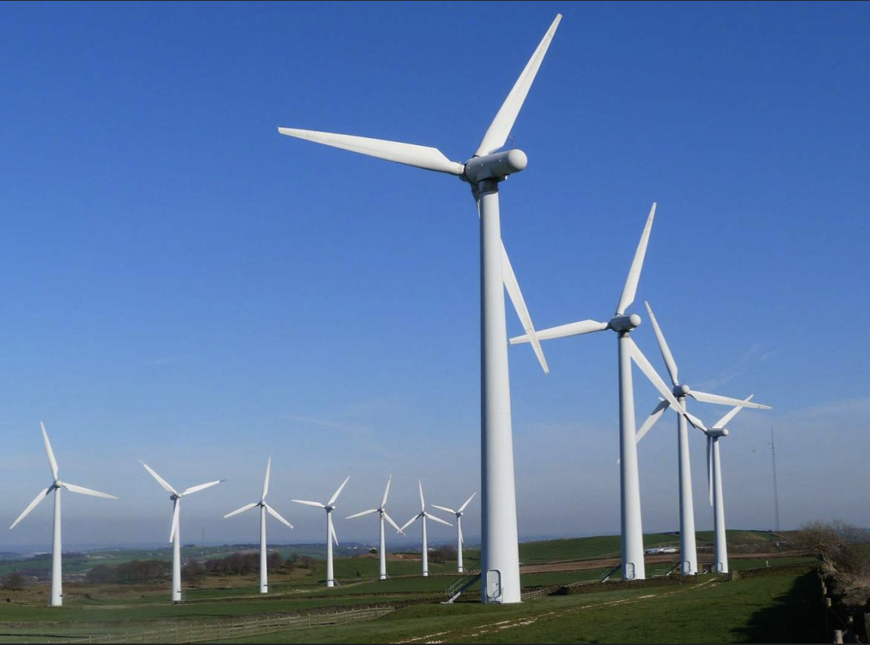
Nearly zero energy municipal and business buildings
Heat pumps replace conventional heating / AC systems
Refurbishment of roofs, facades, and windows
LED lighting conversion, smart lighting
National government commitment - 74% renewable electricity by 2030
Electrification public transport and freight
Change citizen behavior: reduce travel; promote walking, cycling, sharing
Minimize and reduce organic waste
Improve recycling
Minimization of construction and demolition waste
Increased solar / wind installations
The NZC Economic Model has been developed to assist you in creating your economic case
While the Climate City Contract does require an economic case, it does not require you to use the NZC model
Waste
Buildings & Heating
Net Zero Carbon
Transportation
Electricity

Slide 5
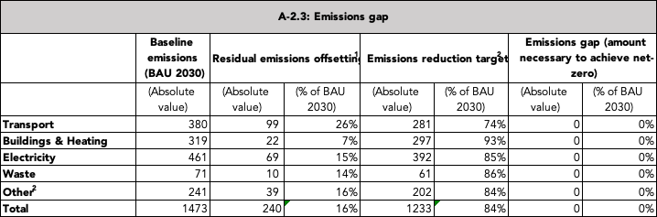

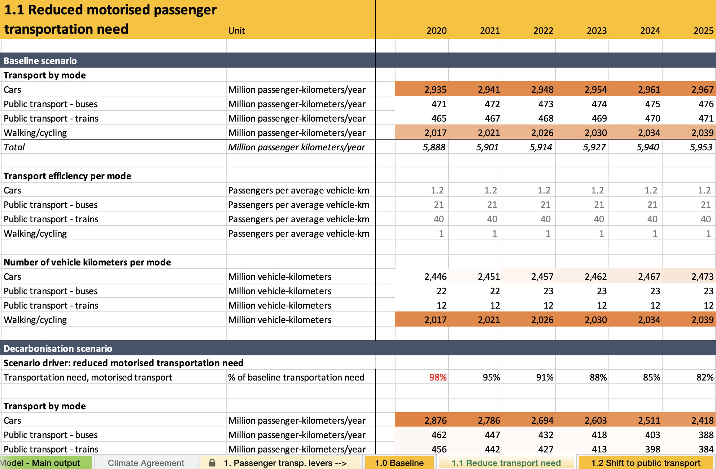
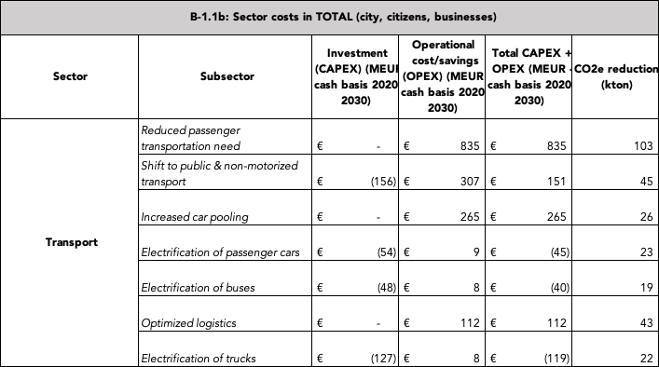
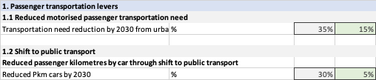
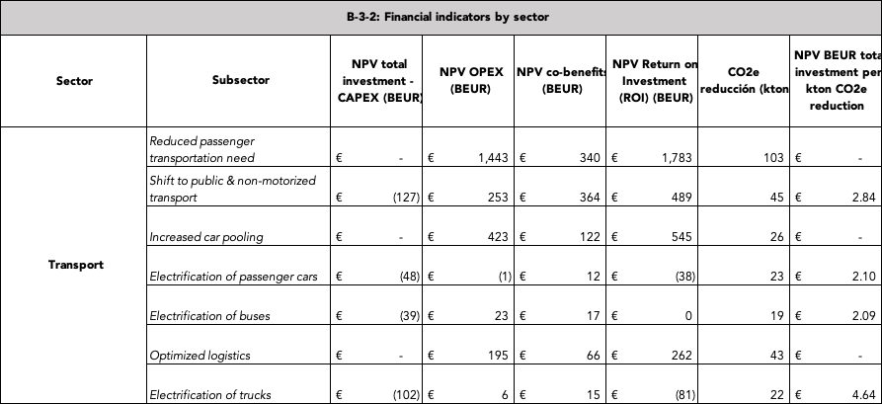
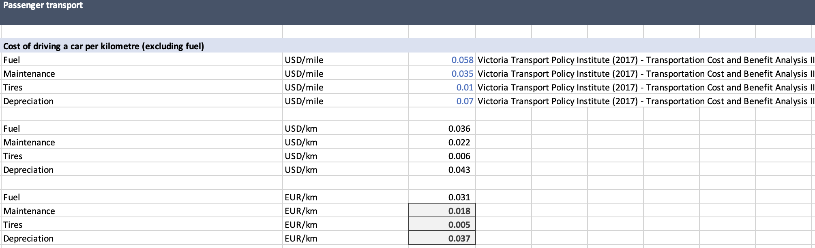
NZC Economic Model is tool for strategic planning
12 formatted tables for CCC
Provided by City
133 city-specific data inputs
Mathematical calculations for validation and analysis
73 city-specific assumptions for 2030
+
Research-based non-city-specific data and assumptions

Slide 6



Economic case includes a number of quantifiable co-benefits arising from decarbonization
Economic growth
Health
Inclusivity
Property value
Road safety
Physical health
Equality
Community assets
Employment
Time savings
Air quality
Noise
Well-being
Transport
Buildings & Energy
Waste
Quantifiable benefits where reliable monetary interpretations exist in literature
Qualitatively evaluated co-benefits

Slide 7
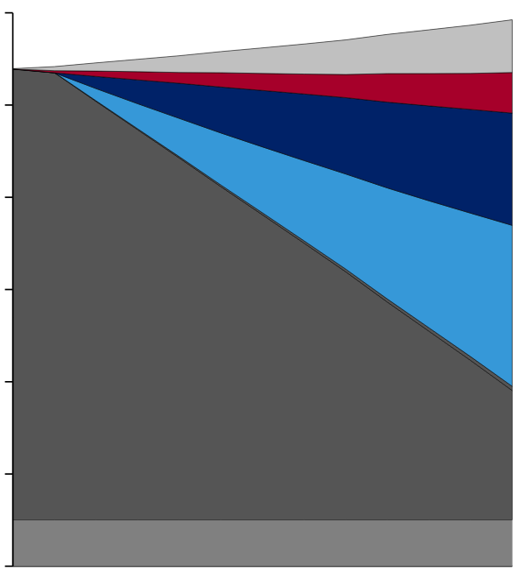
Example: Model outputs show emissions reduction in 2030 resulting from implementation of Climate Action Plan
CO₂ abatement curve for total emissions of CO₂
kton CO₂ per year
1473 kton
Baseline improvements
Carbon reductions are calculated versus the 2030 Business as Usual case – In this example, BAU emissions in 2030 are similar to 2020
In this example, sub-sectors in transport, buildings and heating, electricity generation and waste can together reduce 84% of emissions in those sectors
Mission goal is to reduce carbon by at least 80% by 2030 and offset the residual to get to net-zero
Transport
-84%
Buildings & heating
Electricity
Waste
Remaining emissions in main sectors
Emissions from other sectors not analyzed
2020
2030
* Chart is not to scale

Slide 8
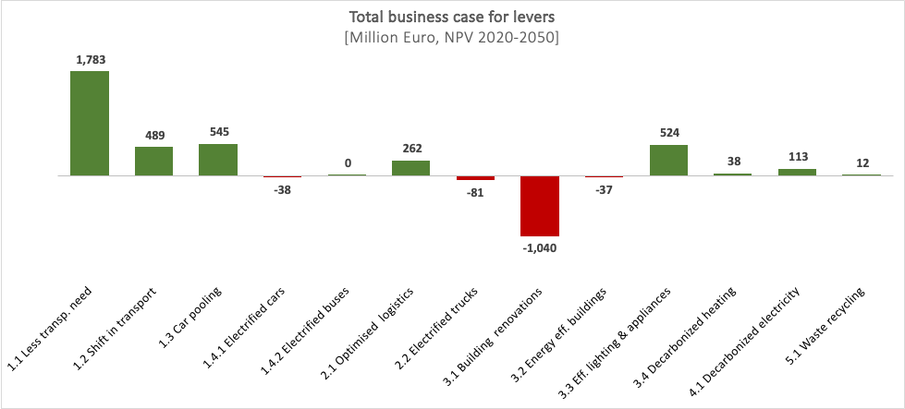
Example: Most of the individual decarbonization sub-sectors have a positive or near-neutral economic case
Abatement cost curve
kton CO₂e emissions in 2030, abatement costs and benefits annualized based on investments in 2020-2030, and recurring costs/savings and co-benefits in 2020-2050
* Increased asset value (equity) from building renovations and decarbonized heating is not included in the model. Inclusion of equity increases would improve the economic case for these levers.

Slide 9
Example: Total economic case shows a very positive Return on Investment (ROI)
Total economic case for all levers
M€, NPV investments (2020-2030) and benefits (2020-2050)
100%
5136 M€
In this example, 2.6 BEUR in incremental investment over and above the Business as Usual (BAU) case is required to implement the Climate Action Plan.
1.0 BEUR comes from co-benefits adding substantially to the overall ROI.
1043 (20%)
2567 M€
4092
(80%)
Upfront investments
Net recurring costs/savings
Co-benefits

Slide 10
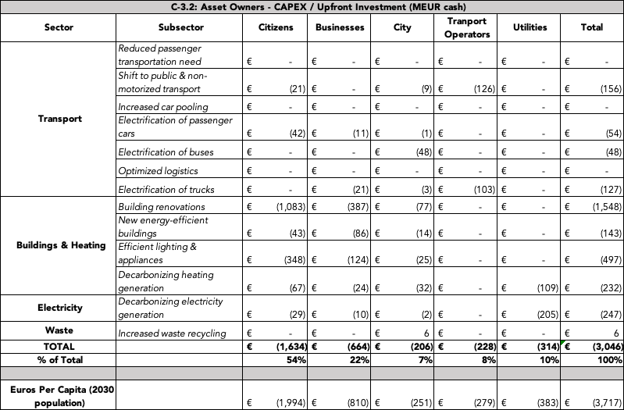
Example: Model output tables feed directly into Climate City Contract
In this example, 3 B€ in incremental investment will be required through 2030 with 206 M€ (7%) spent by city directly

Slide 11
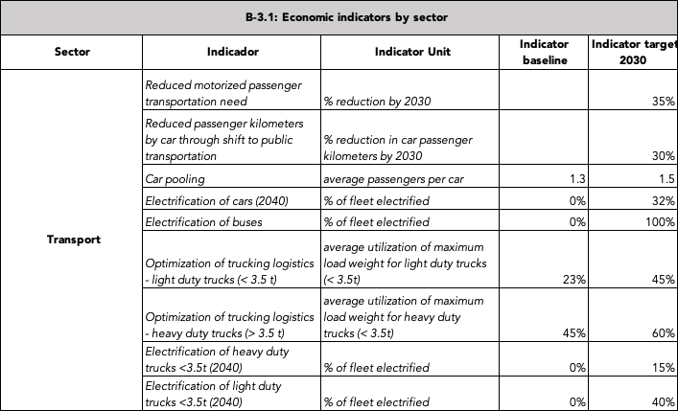
Output example: model output table aligns with MEL framework to provide a summary of baseline and 2030 targets for Key Performance Indicators (KPIs)

Slide 12
Benefits of using the NZC Economic Model
The model, process, and consulting support are free to cities.
It produces the vast majority of numerical tables for the Climate City Contract in the format required. This allows city climate teams to spend more time using the analysis to inform their strategic plan rather than worrying about what numbers fit in what boxes.
The model results inform and are informed by the strategic plan as documented in the Climate City Contract (CCC). It can be used for “what-if” analysis and updated easily over time, so the CCC becomes a working document and roadmap to help the city achieve its goals rather than an administrative exercise.
Calculating Return on Investment including co-benefits helps to make the case to city leaders for allocations of limited budget resources. It also helps citizens and businesses understand the returns they can expect from the substantial decarbonization investments that will be required of them.
It provides high level backup to support incremental Investment Planning and the financing necessary to fill budget shortfalls.
It can serve to bridge the communication gap between city climate teams and city finance departments, so they can work together to make sure the Climate Action Plan is properly funded.
A consistent analytical approach allows for the comparison of results across cities improving accuracy and highlighting decarbonization best practices to be shared.

Slide 13
Process for working with NZC to create an economic case using the model
Getting the most accurate inputs for the model data input sheet is critical to getting the most accurate forecast of carbon and cost / benefits aligned with each city’s Climate Action Plan – cities that actively engage in the process take about 1 ½ months to complete their economic case:
  Placeholder data is provided for each input cell to serve as an accuracy check for city specific inputs or a default where data does not exist.
  Cities fill in emissions inventory data (usually for 2019 to avoid the unusual effects of COVID); cities fill in assumptions for 2030 to reflect the expected effects of their Climate Action Plans – timeframe: ~ 3 weeks
  Model calculations by the main sectors of Transportation, Buildings & Heating, Electricity, and Waste are compared to the carbon emissions calculated in the original emissions inventory (e.g. SECAP) to highlight possible issues with data inputs and / or possible issues with emissions inventory calculations. – timeframe: ~ 1 week
  Whatever emissions do not fall in the main sectors (such as Industry, Agriculture, Ports, Airports, Freight Rail etc.) are put in a sector called “Other”. The city emissions inventory is assumed to be the best estimate of Other which is then used in the model.
  Sector emissions and key performance indicators are compared across cities to highlight and address any additional issues with data inputs or assumptions.
  Cities adjust 2030 assumptions to better align with their Climate Action Plan and to get closer to the 80% carbon reduction goal of NZC. – timeframe: ~ 2 weeks
Inventory
data
Model calculations
1 week
City adjustments
2 weeks
3 weeks

Slide 14
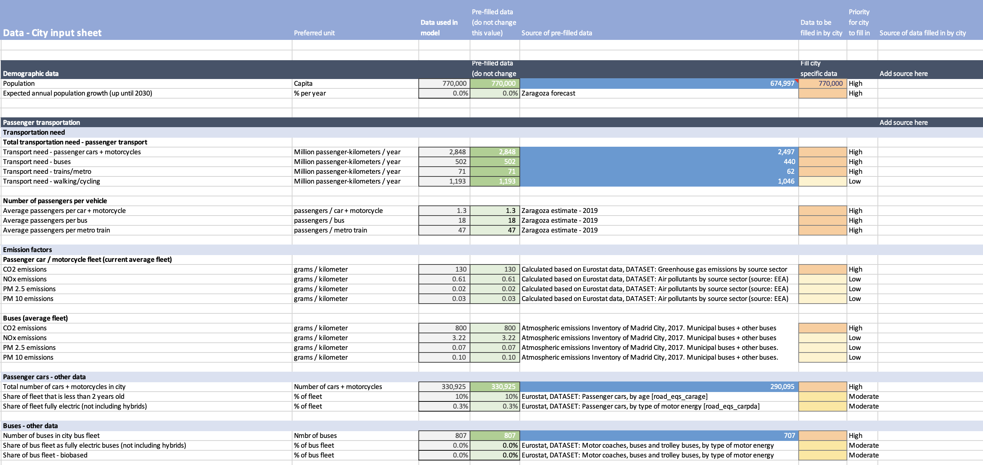
Screenshot of data input sheet

