Slide 2
Climate City Contract Iterations
Information Session
Contact: silvia.gugu@iclei.org

Slide 3
Climate City Contract (CCC) Iterations
11.00-11.05 About process: how does the CCC iteration process unfold with NetZeroCities? (Silvia Gugu, ICLEI)
11.05-11.10 About updating CCC content: amplifying commitments (Silvia Gugu, ICLEI)
11.10-11.20 Q&A
11.20-11.30 About updating CCC content: accelerating climate action (Nikhil Chaudhary, CKIC / Paul Barton, ICLEI)
11.30-11.40 Q&A
11.40-11.50 About updating CCC content: financing climate action (Ryan McManus / Harry Wain, BwB)
11.50-12.00 Q&A
Please feel free to record your questions in the chat as we go. If we won´t manage to answer all questions during the session, we will follow up by email. All questions and answers from both sessions will be assembled in a FAQ document and posted on the NetZeroCities portal together with the recording of the session.

Slide 4
About process:
How does the Climate City Contract iteration process unfold with NetZeroCities?

Slide 5
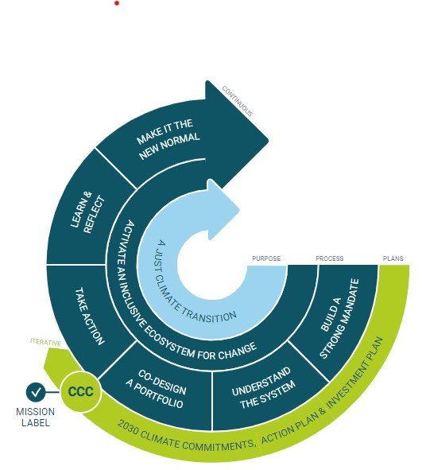
Why undertake a CCC iteration?
Assess progress over time, by leveraging and incorporating the feedback provided by the European Commission and the Mission Platform; by building on Monitoring, Evaluation and Learning, and pinpointing challenges and opportunities as they occur
Refine and scale up strategies and actions in response to evolving conditions and new insights
Strengthen commitment by taking ownership, especially as a new city government, widening the range of stakeholders engaged at all governance levels, and deepening citizen engagement and the shared sense of ownership of the CCC
Notes:
As your Climate City Contract implementation progresses, insights will emerge that were not possible to predict up-front. Therefore, a process of continuous stock-taking, re-alignment, and maintaining momentum will be needed. This process may result in a need to update the Climate City Contract to:
address feedback received on the first CCC version
showcase new commitments from stakeholdersgroups, including new team members
update strategies and actions to adapt to changingconditions (e.g., new insights fromimplementation, structural political or economicchanges etc)
take stock of progress to date as an individual city,but also in the context of a changing political andphysical environment. in order to identify eventualsupport needs
other

Slide 6
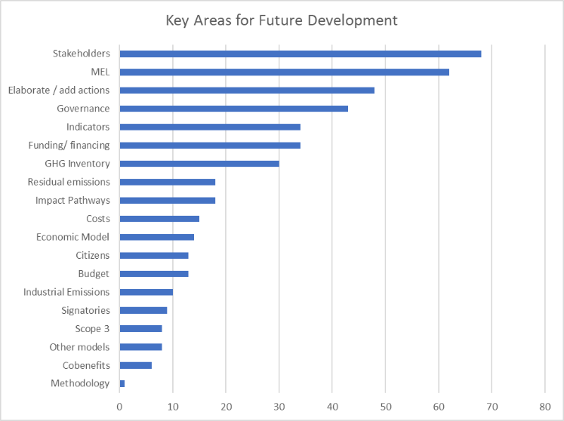
Why undertake a CCC iteration?

Slide 7
When undertake a CCC iteration?
Most Mission Cities expressed the intention of updating their CCC yearly or every two years.

Slide 8
CCC iterations as a city-driven process
Flexible timeline – recommended every two years
Modular scope - cities set their own ambitions with the iteration
City-facing guidance responding to city priorities and drawing on examples of city best-practice
Tailored support from the Mission Platform: two optional tracks based on city needs

Slide 9
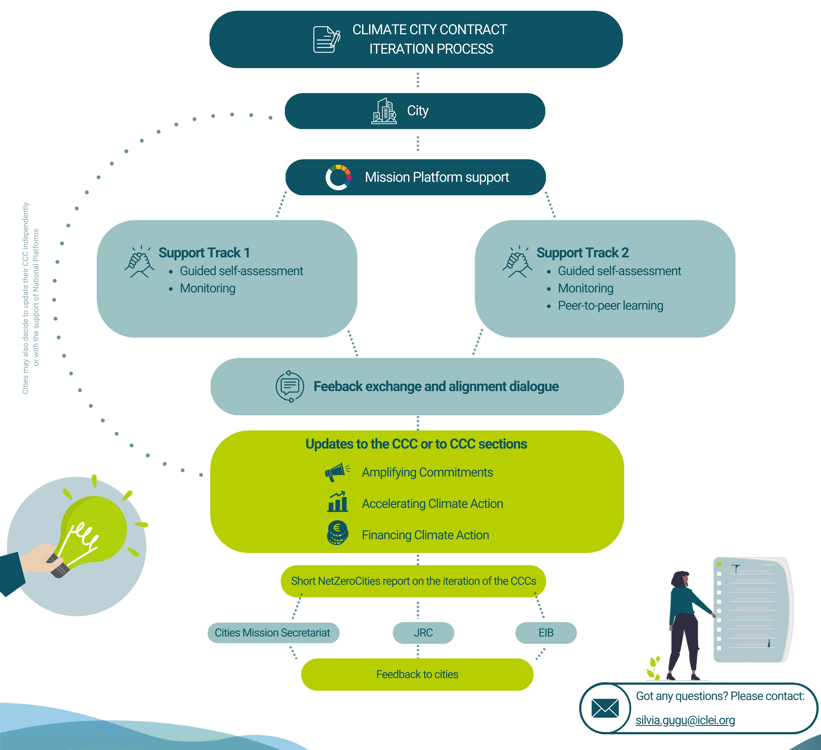
Step 1.
Discuss your CCC iteration plan with your City Advisor.

Slide 10
Step 2:
Determine the appropriate CCC iteration support for your needs

Slide 11
Step 2:
Determine the appropriate CCC iteration support for your needs
TRACK 1
Self assessment: we provide a bespoke self-reflection tool for you to identify your city´s support needs for CCC iteration
Needs-based monitoring support: outcome harvesting, improved MEL system, data-based sense making, overall progress update, NetZeroPlanner etc

Slide 12
Step 2:
Determine the appropriate CCC iteration support for your needs
TRACK 2
Self assessment: we provide a bespoke self-reflection tool for you to identify your city´s support needs for CCC iteration
Needs-based monitoring support: outcome harvesting, improved MEL system, data-based sense making, overall progress update, NetZeroPLanner etc
Peer-to-peer learning facilitated by NetZeroCities: technical guidance updates and best practice, thematic learning

Slide 13

Step 2:
Determine the appropriate CCC iteration support for your needs

Slide 14
Step 3:
CCC update and uploading on the NetZeroCities Platform

Slide 17
About updating CCC content
Part I: Amplifying Commitments

Slide 18

Amplifying Commitments
The iterative process enables cities to reaffirm their climate neutrality goals and enhance their targets by:
Refining the climate neutrality goal and strategic priorities
Reviewing the process and underlying principles
Amplifying engagement and including additional signatures

Slide 19
Amplifying Commitments
1.1 Refining the climate neutrality goal and strategic priorities
Possible elements to be reviewed:
Geographical scope, emission sources and sectors or gases updates to the 2030 climate target.
References to the co-benefits.
This approach helps:
Strengthens stakeholder buy-in by highlighting benefits beyond emissions reduction.
Fosters cross-sector partnerships by aligning climate and social/economic goals.
Improves policy coherence through integration with urban planning and development.
Did you know?
In the first version of their CCC, Mission Cities committed to climate neutrality while focusing on achieving other co-benefits:
Further readings
Cities can align with or get inspired from one or more of the existing taxonomies published to support them in selecting and measuring co-benefits, for example:
C40’s Urban Climate Impact Framework
ICLEI’s Climate Neutrality Framework
World Bank’s Urban Sustainability Framework
public health
citizens’ wellbeing
economic growth
environmental co-benefits

Slide 20
Amplifying Commitments
1.2 Reviewing the process and underlying principles
In their first CCC submissions, cities have adhered to principles such as co-creation, open innovation, transparency, sufficiency, or just transition and leaving no one behind. In their CCC iterations, cities see an opportunity to translate these principles into concrete actions, ensuring that climate policies and initiatives are not only ambitious but also inclusive, equitable, and effective.
Did you know?
The city of Lyon has strategically integrated the principle of sobriété (sufficiency) into the development of its CCC, aligning with its broader commitment to climate neutrality. By embedding sufficiency into strategies, policy, and public engagement, the city ensures that resource-conscious living becomes a cornerstone of its path to climate neutrality.
Swedish cities emphasized strengthening the Just Transition principle in their 2024 CCCs iterations by integrating social justice into climate strategies, ensuring inclusive participation, and prioritizing initiatives with multiple social, economic, and environmental benefits.
Further readings
Accelerating Just Transitions: Insights for Cities and National Platforms

Slide 21
Amplifying Commitments
1.3 Amplifying engagement and including additional signatures
Achieving climate neutrality requires broad collaboration beyond city governments, as responsibilities are often fragmented. CCC updates offer a key opportunity to expand partnerships and strengthen shared ownership across sectors and governance levels.
Amplifying engagement with other levels of government
Amplifying engagement with the private sector
Amplifying engagement with civil society
Did you know?
In Finland, the Ministry of Economic Affairs and Employment and the Ministry of the Environment issued a joint commitment document outlining the kind of support granted to Mission Cities:
  Policy Support
  Direct Funding
  Collaboration & Networks
Both Cork and Kalamata have developed synergies with the private sector integrating the Local Green Deal approach into their work on CCCs
Further readings
Local Green Deals a Blueprint for Action
Local Green Deals: A Governance Innovation to Accelerate the Twin Transition

Slide 23
About updating CCC content
Part II: Accelerating Climate Action

Slide 24

2. Accelerating climate action
The iterative process allows cities to reflect on their achievements and successes, learn from the implementation process, and adjust their climate neutrality action plan accordingly.
GHG accounting, updating the baseline inventory, reporting successive inventories, and integration of scope 3 emissions.
Reassessment of current policies, strategies and of systemic barriers to 2030 climate neutrality.
Adjust impact pathways and portfolio design, further develop the strategy for residual emissions.
Assess current selection of indicators and co-benefits.
Consolidating and showcasing governance and social innovation interventions.

Slide 25
2. Accelerating climate action
2.1 GHG accounting, baseline inventory and scope 3 emissions
A GHG baseline inventory is a critical component of climate action planning, serving as the reference point for setting emissions reduction targets. Regular and comprehensive reporting ensures that cities can assess trends, provide evidence for adjusting policies, and align strategies with evolving climate goals.
Update baseline inventory to meet Info Kit requirements
Report successive inventories, utilising the reporting platforms, NZC Barometer and NZC Reporting Helpdesk
Begin to incorporate Scope 3 emissions into climate accounting and planning
Did you know?
Valencia has become the first city worldwide to measure the carbon footprint of its tourism sector, incorporating Scope 3 emissions. Since the city government does not have direct authority over various tourism-related sectors, such as hotels, event planning, and transport services, which largely contribute to Scope 3 emissions, this partnership leveraged advanced big data tools to assess the impact. By categorizing these emissions into ten sectors, including transportation, food services, and public utilities, the analysis identifies the most carbon-intensive activities, allowing for more precise mitigation efforts. Using these insights, the initiative is introducing a blockchain-based digital system that monitors emissions in real time, helping businesses reduce their environmental impact (UN Tourism, 2021).
Further readings
Reporting for Mission Cities on CDP-ICLEI Track
Reporting for Mission Cities on MyCovenant

Slide 26
2. Accelerating climate action
2.2 Current policies, strategies and systemic barriers
CCC iterations can be an opportunity to update and validate the models that went into computing the “emissions gap”, the difference between the city´s greenhouse gas emission reduction target and emissions reduction accomplished through existing action plans Updates can include:
Ensure there is no double counting of actions.
Quantifying emissions impacts of actions that previously had no impact estimate.
Inputting new or collected data into the model used for estimating impacts.
As cities refine their CCCs, improving the mapping of barriers and stakeholders can strengthen the coherence between identified challenges and planned actions. CCC iterations are an opportunity to highlight solutions and contingency measures to challenges and barriers.
Did you know?
To enhance the coherence between stakeholder mapping, barrier analysis, and actionable climate measures, the city of Bologna adapted its Action Plan template to align with the insights gained from its stakeholder and systemic barrier mapping. This approach ensured that the identified challenges and opportunities were directly linked to the actions outlined in the CCC, fostering a more integrated and coherence roadmap toward climate neutrality.
Further readings
Chapter: Anticipatory governance, in “Climate City Contract Case Studies Anthology V1” (Forthcoming)

Slide 27
2. Accelerating climate action
2.3 Impact pathways and portfolio design
The impact pathways template for CCCs were designed to include ‘Early Outcomes,’ which are expected to appear 1-2 years into the implementation phase, and provide the opportunity for early evaluation and sensemaking of the outline actions.
Analyse the significance of the Early Outcomes of your Impact Pathways.
Observe which Actions led to these achievements and which were less successful and why.
Look ahead and adjust the implementation strategies accordingly, with a focus on conditions which will enable the Impact Pathways aspire to.
Table 2.2 - Looking ahead
Focus area | Key questions
Future planning and impact | What key enabling factors are important in the upcoming stages of your climate actions? How will they contribute to achieving long-term outcomes and impacts? What emerging needs have you identified that will require dedicated action during the next stages of your pilot’s implementation?
Future opportunities | What synergies or opportunities have you identified, either within your team or through external partnerships?
Problem-solving and risk management | How can your current understanding of the challenges help overcome barriers or risks?
Strategic alignment and policy integration | How can the actions plan contribute to other policies and plans, perhaps at other levels of governance?

Slide 28
2. Accelerating climate action
2.4 Strategy for residual emissions
Since emission compensation will likely be required to reach net zero, cities should assess their anticipated residual emissions early and integrate a clear plan into their CCC Iteration.
Residual emissions can be addressed through:
Natural or technological carbon sinks within the city
Purchasing certified carbon credits from external sources that meet strict verification standards.
Did you know?
Ljubljana´s CCC is one that stands out for its clear strategy on residual emissions (the document can be consulted on the NZC portal). It estimates the residual emissions in each sector and provides clear explanations why these emissions cannot be reduced by 2030. This information is complemented by an array of concrete measures to be implemented, including estimates of how much CO2 these measures could remove. The city also provides the cost estimates for these measures.
Further readings
Carbon Removals and Carbon Farming

Slide 29
2. Accelerating climate action
2.5 Indicators and co-benefits
To ensure effective climate action, cities must regularly assess whether they are on track to meet their targets and whether their indicators accurately reflect progress. Choosing and monitoring effective indicators plays a key role in capturing and sharing progress.
Cities are increasingly finding political and financial value in measuring and communicating co-benefits of climate actions.
These indicators should be part of a broader MEL system, with successful cities developing systems that support organisational learning, capacity building, and strategic adaptation.
Did you know?
Leuven is developing an innovative impact framework to better understand and quantify the co-impacts of its climate breakthrough projects across all emission domains. Where possible, these co-impacts—such as improved health, reduced flooding, or increased well-being—are expressed in monetary terms to complement financial business cases. The early version of the framework includes selected indicators and automated calculation methods, tested on a small set of projects, and received positive feedback from financial stakeholders.
Further readings
NZC Comprehensive Indicator Framework
Methodologies and Tools for GHG & Economic Accounting

Slide 30
2. Accelerating climate action
2.6 Governance innovation interventions
As cities go through their CCC iteration, they might want to showcase changes in their governance and policy approaches.
Capacity building for an improved MLG integration and collaboration.
Review, learn, and scale up pilots.
Reporting, inspiring, advocating to enable replication.
Formalizing experimental approaches by creating rules and standards.
Did you know?
Among the provided examples there is:
Capacity building programme in Turku (Finland) to mainstream the application of the EU Taxonomy across city departments.
Paris‘ incremental implementation of sustainable mobility policy.
The case of Cluj-Napoca and the establishment of the Mission Mirror Cities Hub Romania (M100).
Aarhus and Kranj digitalization and data-driven approaches.

Slide 31
2. Accelerating climate action
2.6 Social innovation interventions
Social innovation, in the means and in the ends, is a key lever of change in socio-technical transformations. The social innovation actionable pathways is a visual framework aimed at supporting public administrations and policymakers in making informed decisions on how to deploy social innovation for sustainability:
Public administration capacity building in social innovation;
Social Innovation task force and strategy making;
Funding for Social Innovation initiatives;
Citizens' capacity building;
City Social Innovation mapping;
Co-creation platforms and environments;
Social innovation policies;
Incubating and accelerating social innovations;
Co-creation and cross-sector partnerships;
Systemic innovation approaches which include social
Did you know?
As part of its climate policy, Mannheim (Germany) established a city lab (EU Horizon project SONNET) to engage Neckarstadt-West residents in energy transition efforts. With language barriers posing challenges, the project introduced mobile participation containers, app-based gamification, and initiatives like energy role model flats and a neighbourhood crowdfunding fund.
Further readings
Social Innovation ActionablePathways for Climate Neutrality: full collection of resources, cases and methods.
NZC Social innovation toolkit.
Bresciani, S. (ed.). (2025). Social Innovation Projects for Climate Neutral Cities. Springer Cham.

Slide 33
About updating CCC content
Part III: Financing Climate Action

Slide 34

3. Financing climate action
As Mission Cities progress in their climate neutrality pathways, updating the Investment Plan becomes a strategic step in aligning ambition with actionable, finance-ready roadmaps. Investment planning is not a one-off effort, but rather a living exercise that reflects evolving actions, updated costing, and financing strategies.
Actions and Investment Pathways
Monitoring, Evaluation and Learning in Finance
Policy and Stakeholder Engagement
Balancing Impact and Effort

Slide 35
3. Financing climate action
3.1 Actions and Investment Pathways
Table 3.1 – Priority Projects Example
An iterative IP should identify which projects are now in development and identify any additional projects that have been added to the action plan since the initial submission.
Cities are encouraged to:
Reassess their priority projects
Assess the funding gap and further explore financing pathways to cover non-municipal costs.
Fields of Action | Action / Indicator
Transportation | New Tramway | Capex (€m) | Opex (€m) | Cost Effectiveness (EUR/tCO2e) | Investment (Split by Stakeholders)
 |  | 600 €m | 20 €m p/a | 16,000 EUR/tCO2e | 30% National Funding 20% Commercial Bank Lending 50% DFI Loan
 |  | Project Description:
Table 3.3 - Funding Gap Example
Field of Action | Action / Indicator | Cost to Municipality € (%) | Cost to Other € (%) | Other | % of Municipal Covered | % of Other Covered
Mobility | New Tram Line | 300m (30%) | 700m (70%) | EIB & National Funds | 100% | 20%
Mobility | Electric Busses | 0m (0%) | 95m (100%) | Private Operator | N/A | 100%
Built Env | Municipal Retrofit | 210m (100%) | 0m (0%) | None | 65% | N/A
Energy | PV Rooftop Solar | 0m | 80m (100%) | Private contractor (PPP) | N/A | 100%

Slide 36
3. Financing climate action
3.2 Monitoring, Evaluation and Learning in Finance
It is recommended that all cities interested in the development of an iterative CIP adopt a robust monitoring framework.
Table 3.4 – Finance and Investment Indicators
Indicator | Unit of Measurement | Calculation
Capital Invested in Climate Action Projects | EUR Million | Annual Spend on Climate Action Projects
Budget Assigned to Climate Action Projects | % of City Budget | Annual Budget Assigned to Climate Action Projects ÷ Annual Municipal Budget
Capital Invested in Climate Action Projects per Capital | EUR Thousand | Annual Capital Invested in Climate Action Projects ÷ Estimated No. of City Residents
External Capital Invested into Climate Action Projects | EUR Million | Annual Capital Invested into Climate Action Projects from External Finance
Coverage of Climate Finance Gap | % of Capital Deficit Covered | Annual External Finance in Climate Action Projects ÷ Finance Gap between Required Investment and Municipal Spend
Emission Return on Invested Capital | EUR Million | Total Capital Invested ÷ kT CO2e Reduction

Slide 37
3. Financing climate action
3.3 Policy and Stakeholder Engagement
Enabling conditions provide the foundations for furthering climate investment within cities, leading directly to fulfilment of the Climate Action Plan and its associated targets. When developing iterative Climate Investment Plans, Mission Cities are encouraged to consider:
New or emerging policy developments that can support additional funding for the city’s climate budget and capital investments, and policies that facilitate further capital flows.
Relevant stakeholders that can support the implementation of their APs and IPs.
Table 3.5 – New and Upcoming Policy for Capital Facilitation and Funding
Climate Policy | Policy Status | Description of the Policy and Intended Outcome
Low Emission Zone | Enacted | The city has implemented a Low Emission Zone within the city centre in order to reduce the number of private vehicles actively entering the city (supporting modal shift) and also raise additional funds for the city’s climate budget.
Local City Commitment Fund | Drafting | The city intends to develop a city fund for local private organisations that are unable to decarbonise. Private corporations will pay contributions in line with their emissions which will be used to fund additional climate activity in the city.
Table 3.6 – Stakeholder Engagement Developments
Stakeholder | Engagement Description
CityBank | The city has been working with locally based CityBank to discuss the opportunity to launch green mortgages and loans for supporting residents with retrofitting of their homes for energy renovation purposes. Discussions are ongoing but CityBank are open to exploring the idea.
InvestorFund | A national investment fund has committeed to exploring the opportunity to develop a city fund for financing of local climate actions and SMEs. This collaboration is ongoing with InvestorFund sitting in advisory meetings to co-create the fund.
Notes:
Refining the climate neutrality goal and strategic priorities
Reviewing the process and underlying principles
Amplifying engagement and including additional signatures

Slide 38
3. Financing climate action
3.3 Balancing Impact and Effort
The iteration of the CCC is not a reporting task. Updating the IP can serve strategic functions:
Strengthen credibility: Demonstrate maturity and coherence in investment planning to partners and funders.
Facilitate learning: Use the updated data to refine the city’s understanding of what is financially feasible or needs external support.
Support iteration: Align investments with updated Action Plans or priorities derived from monitoring and self-assessment processes.
Enable prioritisation: Identify where climate action momentum is already building and where additional capital is needed most urgently.
The update of Ips can be informed by:
Progress tracking from ongoing implementation;
Updated cost data from pilot projects or procurement rounds;
Stakeholder consultations (e.g., with local utilities, mobility providers, or finance departments);
Inputs from city advisors or national platforms supporting investment readiness.
Notes:
Refining the climate neutrality goal and strategic priorities
Reviewing the process and underlying principles
Amplifying engagement and including additional signatures

Slide 40
Resources
Resource Pack 3.0: CCC Iterations
Focus on: Climate City Contracts

Slide 41
Contact
Resource Pack 3.0: CCC Iterations
Focus on: Climate City Contracts

