Slide 1

Economic Case for Decarbonization
Process and model scope / methodology
March 23, 2023

Slide 2
Agenda
Modelling Process
Analytical Scope
Appendix - Model methodology

Slide 3
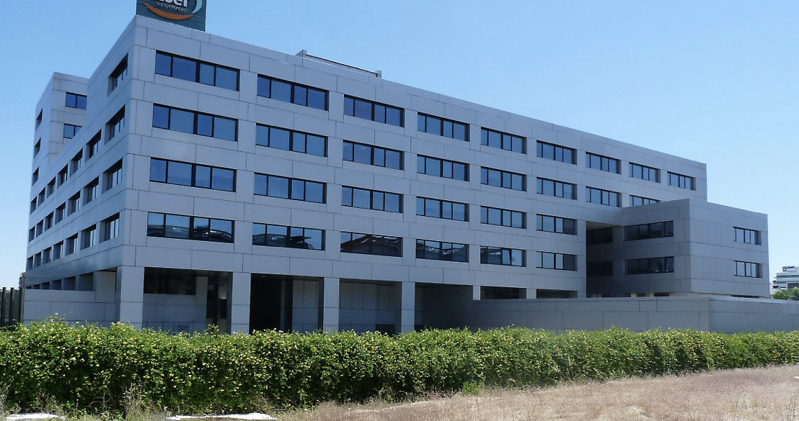

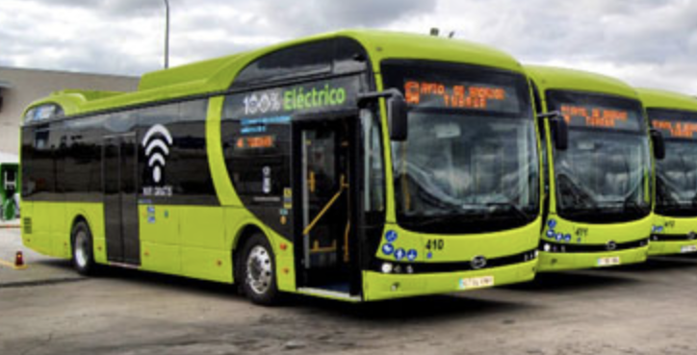
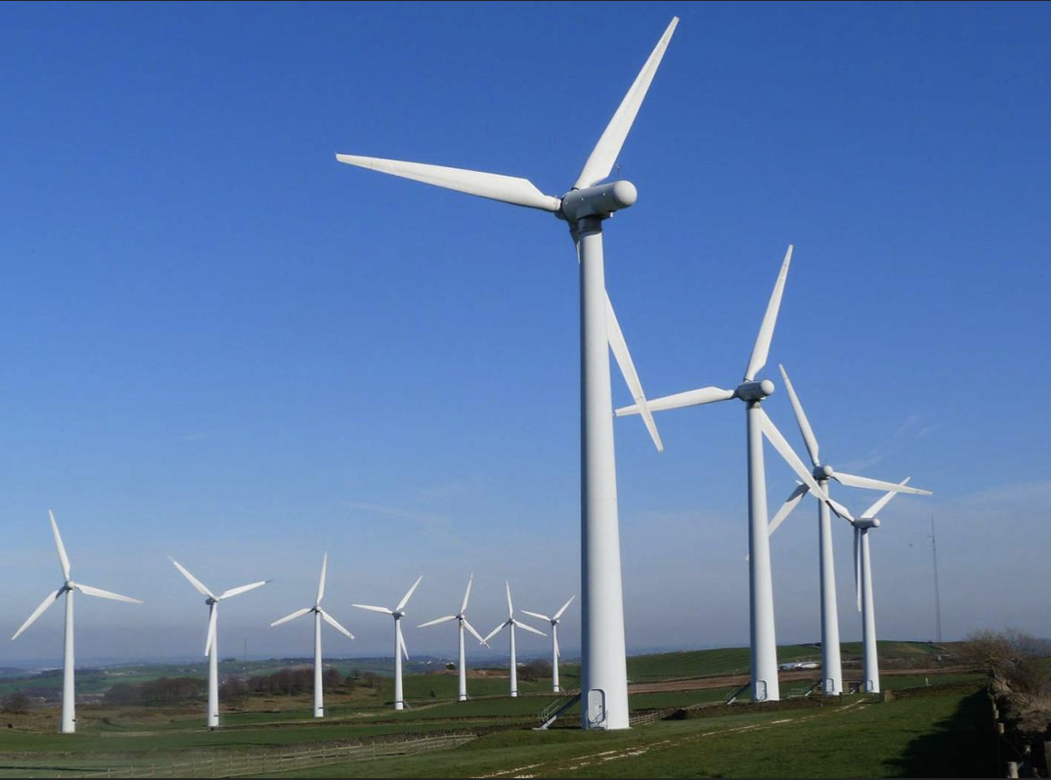
Nearly zero energy municipal and business buildings
Heat pumps replace conventional heating / AC systems
Refurbishment of roofs, facades, and windows
LED lighting conversion, smart lighting
National government commitment - 74% renewable electricity by 2030
Electrification public transport and freight
Change citizen behavior: reduce travel; promote walking, cycling, sharing
Minimize and reduce organic waste
Improve recycling
Minimization of construction and demolition waste
Increased solar / wind installations
Decarbonization and economic analysis is based on each city’s Climate Action Plan
Waste
Buildings & Heating
Net Zero Carbon
Transportation
Electricity

Slide 4
The Climate City Contract (CCC) documents city net-zero commitments along with the roadmap and strategy for achieving the Climate Action Plan. The Economic Model is an analysis tool to create that forecast for inclusion in the CCC.
Climate Action Plans
Model Analysis Breakdown
Goal is 80% carbon reduction off 2030 BAU case (20% residual can be offset)
Climate City Contracts
Map model results to Climate City Contract.
Manage to Plan
Report on progress
13 decarbonization sub-sectors
Maximize ROI
Asset owners
CAPEX vs OPEX
Benefits incl. co-benefits
Define annual decarbonization and cost as a roadmap for cities.
Incremental Investment Needed / Funding Gaps
Work with city finance to map plan to budget
City Investments / Other Asset Owners
90+% of investments not under city control
Funding gaps: seek out alternate funding and/or adjust plan
Adjust implementation to stay on track to net zero goals
Decarbonization projects and timing
Document incentives and regulations to motivate others to invest
Decarbonization and Economic Modeling Process

Slide 5
Objectives of decarbonization economic modelling process
Purpose: Adapt and refine the tool to each city, to enable quantification of the economic case for decarbonization – to build the rationale for ambitious climate action, support strategy and identify priority areas as defined in the Climate City Contract
Key elements and benefits of the model
Purpose of the city decarbonization tool – what it can be used for by each city
Quantification of city “Business as Usual” scope 1 and 2 emissions* in 2020 and in 2030
City data inputs are used to create year 2020 baseline
Analysis of emission reduction potential from 13 decarbonization sub-sectors aligned with city’s Climate Action Plan
13 decarbonization sub-sectors typically make up 90%+ of city’s Scope 1 and 2 emissions
Quantification of economic case for each sub-sector, including co-benefits
Quantify costs and benefits of climate related initiatives to maximize decarbonization and monetary Return on Investment (ROI)
Understand investments required of different stakeholder groups as the foundation for Investment Planning
Test impact of increasing ambition level for certain targets
Visualize & quantify the wide range of co-benefits from climate action.
Integration tool in strategic decision making to enable data driven way of working
Comparisons across cities to highlight and share best practices
* And scope 3 for waste disposed of outside of the city

Slide 6
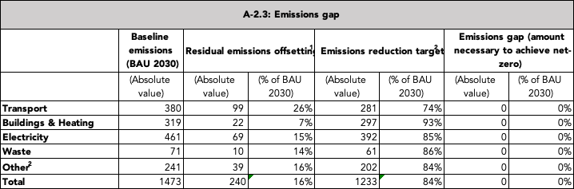

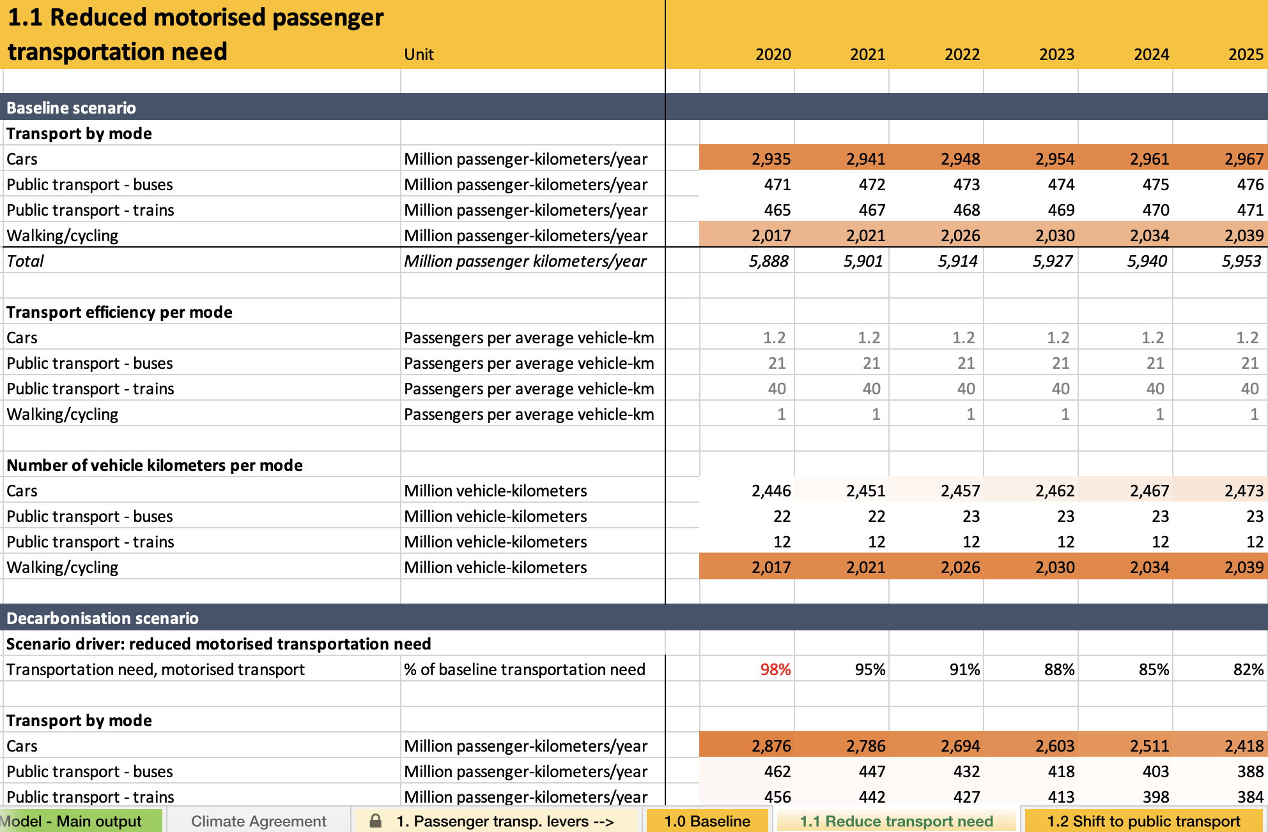
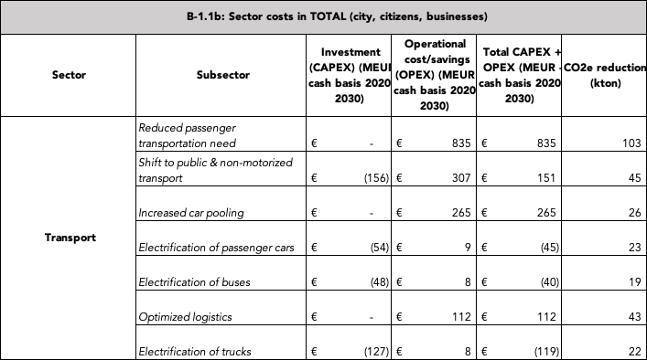
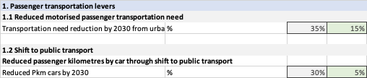
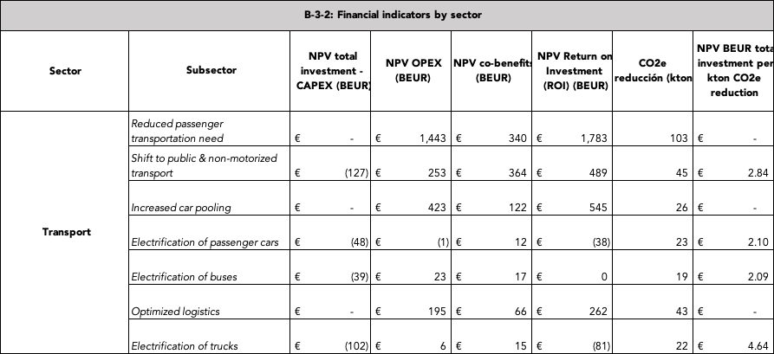
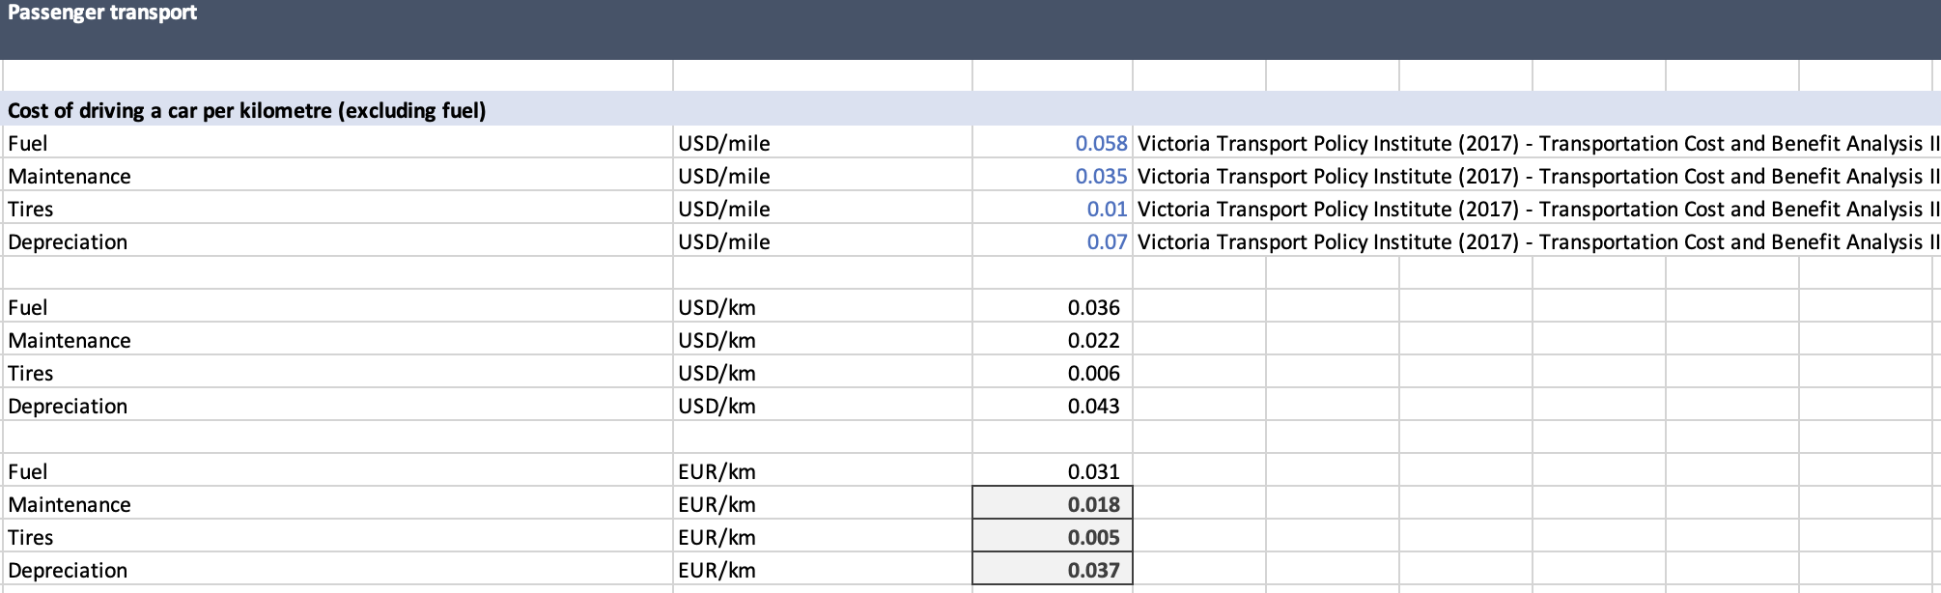
NZC Economic Model is tool for strategic planning
12 formatted tables for CCC
Provided by City
133 city-specific data inputs
Mathematical calculations for validation and analysis
73 city-specific assumptions for 2030
Model also includes hundreds of non-city-specific data inputs and assumptions

Slide 7
Agenda
Modelling Process
Analytical Scope
Appendix - Model methodology

Slide 8
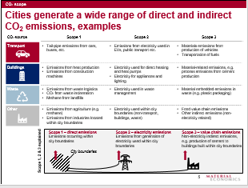
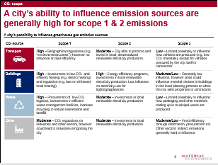
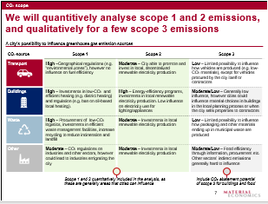
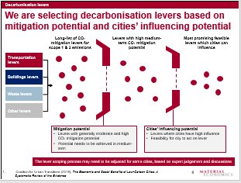
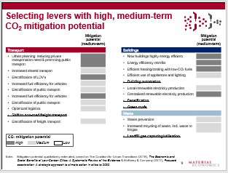
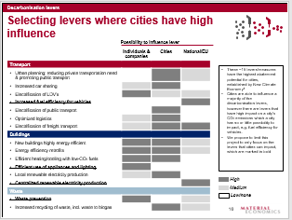
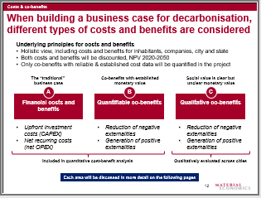
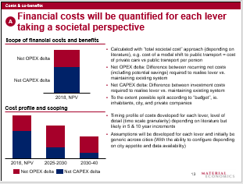
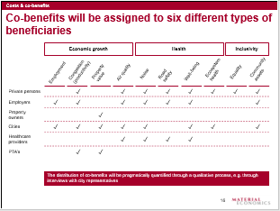
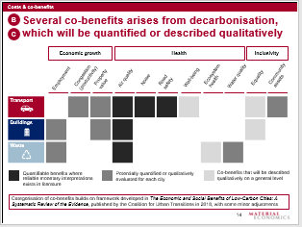
Scope of economic case analysis
Key considerations | Proposed scope
CO₂ scope – what emissions to include? | Include scope 1 & 2 emissions in the economic case, as cities can often influence these emission sources Scope 3 emissions are included only for city waste disposed of outside of city borders
Decarbonization sub-sectors – which sub-sectors to model? | Quantify economic case for 13 abatement sub-sectors within Transportation, Buildings & Heating, Electricity, and Waste Selection of sub-sectors based on expected impact and possibility for cities to influence
Costs & co-benefits – which costs to include and co-benefits to quantify? | Societal perspective on costs and benefits (not limited to city boundaries), net OPEX & CAPEX delta Quantify financial costs/benefits, air quality, noise and road safety

Slide 9






Cities generate a wide range of direct and indirect CO₂e emissions
Non-exhaustive
CO₂ source | Scope 1 | Scope 2 | Scope 3
Transport | Tail-pipe emissions from cars, buses, etc. | Emissions from electricity used in EVs, public transport etc. | Materials emissions from production of vehicles Transportation of fuels
Buildings & energy | Emissions from heat production Emissions from construction machines | Electricity used for direct heating and heat pumps Electricity for appliances and lighting | Material-related emissions, e.g. process emissions from cement production
Waste | Emissions from waste logistics CO₂ from waste incineration Methane from landfills | Electricity used in waste management | Material embedded emissions in waste (e.g. plastic packaging)
Other | Emissions from agriculture (e.g. methane) Emissions from industries located within city boundaries | Electricity used within city boundaries (non-transport, buildings, waste) | Food value chain emissions Other indirect emissions (non-electricity related)
Scope 1 – direct emissions
Emissions occurring within city boundaries
Scope 2 – electricity emissions
Emissions from generation of electricity used within city boundaries
Scope 3 – value chain emissions
Non-electricity indirect emissions, e.g. production of cement to buildings built within city boundaries
Scope 1, 2 & 3 explained
City boundaries

Slide 10
13 decarbonization sub-sectors selected based on mitigation potential and cities’ influencing potential
Long-list of CO₂ mitigation sub-sectors for scope 1 & 2 emissions
Sub-sectors with high medium term¹ CO₂ mitigation potential
Most promising feasible sub-sectors which cities can influence
Transportation sub-sectors
Buildings & heating sub-sectors
Electricity sub-sectors
Waste sub-sectors
Mitigation potential
Sub-sectors with generally moderate and high CO₂ mitigation potential
Potential needs to be achieved in medium-term
Cities’ influencing potential
Sub-sectors where cities have high influence
Feasibility for city to act on sub-sector
1. Until 2030

Slide 11
Economic case quantifies carbon abatement and costs for emissions that city can more easily influence
CO₂ scope
A city’s possibility to influence greenhouse gas emission sources
CO₂ source | Scope 1 | Scope 2 | Scope 3
Transport | High –Geographical regulations (e.g. “environmental zones”), however no influence on fuel efficiency | Moderate – City able to promote and invest in local, decentralized renewable electricity production | Low – Limited possibility to influence how vehicles are produced (e.g. low-CO₂ materials), except for vehicles procured by the city itself or contractors
Buildings | High – Investments in low-CO₂ and efficient heating (e.g. district heating) and regulation (e.g. ban on oil-based local heating). | High – Energy-efficiency programs, investments in local renewable electricity production. Low influence on electricity use for lighting/appliances | Moderate/Low – Generally low influence, however cities could influence material choices in buildings in the local planning process or when the city sells properties to contractors
Waste | High – Procurement of low-CO₂ logistics, investments in efficient waste management facilities, increase recycling to reduce incineration and landfill | Moderate – Investments in local renewable electricity production | Moderate/Low – Influence waste management outside of city boundaries. Limited possibility to influence how materials ending up in municipal waste are produced.
Other | Moderate – CO₂ regulations on industries and other sectors, however could lead to industries emigrating the city | Moderate – Investments in local renewable electricity production | Moderate/Low – Food efficiency through information, procurement etc. Other sectors’ indirect emissions generally hard to influence

Slide 12
When building an economic case for decarbonization, different types of costs and benefits are considered
Underlying principles for costs and benefits
Holistic view, including costs and benefits for citizens, businesses, and city
Both costs and benefits are discounted, NPV 2020-2030/40/50 depending on the cost/benefit
Only co-benefits with reliable & established cost data are quantified in the project
The “traditional”
economic case
Co-benefits with established
monetary value
Social value is clear but
unclear monetary value
A
B
C
Financial costs and benefits
Quantifiable co-benefits
Qualitative co-benefits
Upfront investments (CAPEX delta)
Net recurring costs (net OPEX delta)
Reduction of negative externalities
Generation of positive externalities
Reduction of negative externalities
Generation of positive externalities
Included in quantitative cost-benefit analysis
Not included in economic case

Slide 13

Financial costs have been quantified for each sub-sector taking a societal perspective
Scope of financial costs and benefits
Calculated with “total societal cost” approach (depending on literature), e.g. cost of a modal shift to public transport = cost of private cars vs public transport per person
Net CAPEX delta: Difference between investments required to realize sub-sector vs. baseline development
Net OPEX delta: Difference between recurring net costs (including potential savings) required to realize sub-sector vs. maintaining existing system
Assumptions are developed for each sub-sector and confirmed with city
Upfront Investments
Benefits
13

Slide 14
Economic case includes a number of quantifiable co-benefits arising from decarbonization
Economic growth
Health
Inclusivity
Property value
Road safety
Physical health
Equality
Community assets
Employment
Time savings
Air quality
Noise
Well-being
Transport
Buildings & Energy
Waste
Quantifiable benefits where reliable monetary interpretations exist in literature
Qualitatively evaluated co-benefits

Slide 15
Investments, recurring costs/savings, and co-benefits are assigned to six different types of asset owners / beneficiaries
Distribution of co-benefits across beneficiaries
Economic growth
Health
Inclusivity
Property value
Road safety
Physical health
Equality
Community assets
Employment
Time savings
Air quality
Noise
Well-being
Citizens |  | ✓ |  | ✓ | ✓ | ✓ | ✓ | ✓ | ✓ | ✓
Businesses |  |  | ✓
Cities | ✓ | ✓ | ✓ | ✓ | ✓ |  |  | ✓ |  | ✓
Healthcare providers |  |  |  | ✓ | ✓ | ✓ | ✓ | ✓
Transport operators |  | ✓ | ✓
Utilities
Investments and recurring costs / savings are distributed across all beneficiaries
Typically, 90+% of investment required will not be under the control of the city, and will need to be made by citizens and businesses. In addition, benefits do not always accrue to the group making the investment.

Slide 16
Model methodology - overview
Sub-sector specific data
Assumptions for sub-sectors
Co-benefits database
Dummy values
City specific inputs
Sub-sector specific data
Costs database
0
1
2
3
Model baseline
e.g. X million vehicle kilometers traveled per year, expected increase of X% per year by 2030, increased efficiency of ICEs (EU regulations)
Model the sub-sector over time and impacts on the current system
e.g. adaptation to EVs as S-curve. CO₂, NOx etc. reduced by X g/km electrified
Model costs and value of co-benefits
e.g. societal costs of NOx of ~9,000 €/t reduced. Initial investment costs of X M€ y1-5, recurring costs of X €/km electrified
Produce outputs
e.g. electrification reduces CO₂ emissions by 2030 by X ktonne, with a positive economic case of X M€
Simple and pragmatic modelling as a function over time
Use average of 2-3 reliable estimates of co-benefit value. Strive to interview experts for important co-benefits
NPV
Investments until 2030
Co-benefits linked to investments until 2040/2050

Slide 17
What does the Economic Model do and not do (and do with manual support)?
City data / assumptions input sheet
Placeholder data for each input to check for accuracy and as a default when data is not available
”What-if” analysis
Easy interface so cities can input their own data / assumptions and evaluate results
Economic model mathematical calculations
Reasonableness check to ensure data input accuracy
Non-city-specific data and assumptions based on EU averages and research studies
Key Performance Indicators (KPIs) and annual forecast goals
Mathematical forecast of carbon and costs benefits to align with Climate Action Plan
All numerical tables for the Climate Agreement except those for alternative emissions inventory calculations and sources of funds
Cost of the Climate Action Plan in CAPEX and OPEX
How CAPEX and OPEX costs will be funded (investment plan)
Euro value of co-benefits
Return on investment by sector, sub-sector, and asset owner group
Cost and benefits at the project level for activities making up the Climate Action Plan
Scope 1 and 2 emissions (Scope 3 for Waste only)
Scope 3 emissions and costing (other than for Waste)
Emissions and costing outside of the four main sectors of Transportation, Buildings, Electricity and Waste (e.g. industry)
Direct investments (costs directly associated with each sub-sector)
Indirect investments (costs associated with strategic investments, incentives, awareness campaigns etc. to motivate behavior)
Reporting on KPIs versus original forecast within MEL framework

Slide 18
Agenda
Modelling Process
Analytical Scope
Appendix - Model methodology

Slide 19
PASSENGER TRANSPORT
Overview of modelling methodology
Main modelling steps
Sub-sectors
The sub-sectors’ impact on kilometres travelled modelled in step A-B
Economic case calculated for each sub-sector, in step C-E
Transportation need (passenger kilometres) for cars, public transport & walking/cycling
C
D
E
Difference in passenger and vehicle kilometres between ‘baseline’ and ‘decarbonization scenario’ for each sub-sector
Noise, accidents, physical activity
Total economic case and CO₂ abatement potential
A
Passenger kilometres
1.1 Reduced motorized passenger transportation need
Reducing passenger kilometres for cars and public transport
New passenger kilometres
Emissions (CO₂ & air pollutants)
1.2 Shift to public & non-motorized transport
Reducing share passenger cars, increasing public & active transport
New passenger kilometres
1.3 Increased car pooling
Increasing average number of passengers per car
Recurring costs/savings (e.g. fuel)
Vehicle kilometres
Vehicle kilometres of cars, public transport & walking/cycling
B
Up-front investments
1.4.1 Electrification of cars
Increasing % of total vehicle kilometres for cars that are electrified
1.4.2 Electrification of buses
Increasing % of total vehicle kilometres for buses that are electrified

Slide 20
FREIGHT TRANSPORT
Overview of modelling methodology
Main modelling steps
Sub-sectors
The sub-sectors’ impact on kilometres travelled modelled in step A-B
Economic case calculated for each sub-sector, in step C-E
Transportation need (tonne-kilometres) for trucks
C
D
E
Difference in vehicle kilometres between ‘baseline’ and ‘decarbonization scenario’ for each sub-sector
Noise, accidents
Total economic case and CO₂ abatement potential
A
tonne kilometres
2.1a Optimized logistics
Reducing total tonne-kilometres driven through route optimisation
New tonne kilometres
Emissions (CO₂ & air pollutants)
Vehicle kilometres of trucks
B
Vehicle kilometres
2.1b Optimized logistics
Reducing total vehicle-kilometres driven through increased utilisation
Recurring costs/savings (e.g. fuel)
New vehicle kilometres
2.2 Electrification of trucks
Increasing % of total vehicle kilometres that are electrified
Up-front investments

Slide 21
BUILDINGS AND HEATING
Overview of modelling methodology
Main modelling steps
Sub-sectors
The sub-sectors’ impact on energy usage and production
modelled in step A-B
Economic case calculated for each sub-sectors, in step C-E
Energy usage for heating and hot water in building stock
C
D
E
Difference in energy usage and production between ‘baseline’ and ‘decarbonization scenario’ for each sub-sector
Total economic case and CO₂ abatement potential
A
Energy demand
Energy demand
Emissions (CO₂ & air pollutants)
3.1 Building renovations
Decreasing the energy demand for heating and hot water in existing building stock
3.2 New efficient buildings
Decreasing energy demand for heating and hot water in new buildings
3.3 Efficient lighting & appliances
Decreasing the energy demand for electricity in new and renovated buildings
Recurring costs/savings
New
energy demand
Up-front investments
Total heat demand for fossil and renewable heating (district and local heating)
B
Energy demand
3.4 Decarbonized heating
Shifting towards renewable sources

Slide 22
ELECTRICITY
Overview of modelling methodology
Main modelling steps
Sub-sectors
The sub-sectors’ impact on electricity production modelled in step A-B
Economic case calculated for each sub-sector, in step C-E
Total electricity demand in the city per source of production
(including increased electricity demand from other sub-sectors)
C
D
E
Difference in share of renewable energy between ‘baseline’ and ‘decarbonization scenario’.
Total economic case and CO₂ abatement potential
A
Electricity demand (TWh)
Emissions (CO₂ & air pollutants)
4.1 Decarbonizing electricity
Increasing share of renewable electricity generation
Recurring costs/
revenues
Up-front investments

Slide 23
WASTE MANAGEMENT
Overview of modelling methodology
Main modelling steps
Sub-sectors
Economic case calculated for each sub-sectors, in step C-E
The sub-sectors’ impact on waste management modelled in step A-B
Total amount of collected waste
C
D
E
A
Difference in share of waste landfilled, incinerated, and sorted for recycling between ‘baseline’ and ‘decarbonization scenario’.
Total economic case and CO₂ abatement potential
Tonnes waste collected
Emissions (CO₂ & air pollutants)
5.1 Increased waste recycling
Reducing tonne waste treated at incineration and landfill stations
Tonnes waste sent to landfill, incineration, or sorting for recycling
Recurring costs/
revenues
Total amount of waste in landfill, incineration, or sorting facilities
B
Up-front investments

