Slide 1
Summer school
Learning Sessions

Slide 2
Learning Session -
Presentations by Cities
Day 2

Slide 3
Cities
Mannheim - Agnes
Milan - Marta
Florence – Chiara & Elena
Malmo – Christian
Aachen – Kristine
Guimaraes – Paulo
Bologna – Chiara (PDF)
Parma – Cristina (PDF)
Lappeenranta – Petri (no slides)
Kosice – Adriana (no slides)

Slide 4
Mannheim

Slide 5

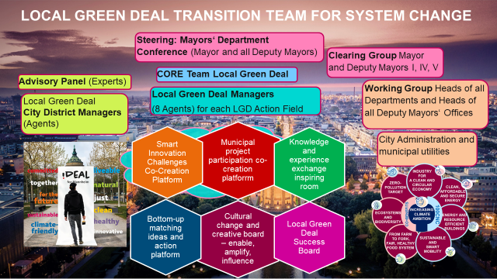
THE SOLUTION: for Mannheim
CHALLENGE/BARRIER 1:
CROSS DEPARTEMENTAL Integrated goals in POLICIES | STRATEGIES
CHALLENGE/BARRIER 2:
FROM AMBITION TO ACTION
Stakeholder COMMItments
Citizen endorsements
CHALLENGE/Barrier 3:
MULTI LEVEL Commitments local Regional National EU

Slide 6

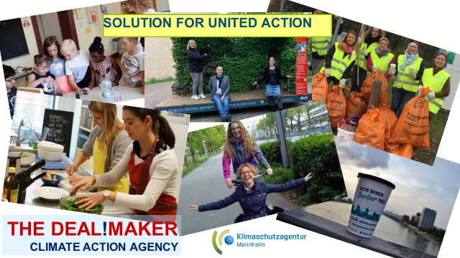

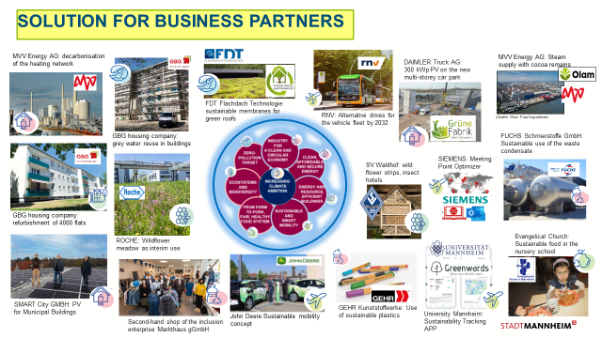
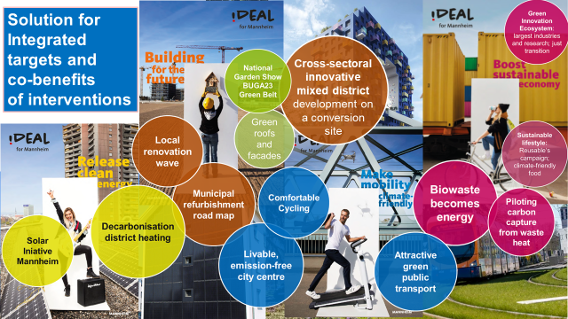
How addresses Challenges|Barriers
SECAP 2030
CCC Mannheim

Slide 7
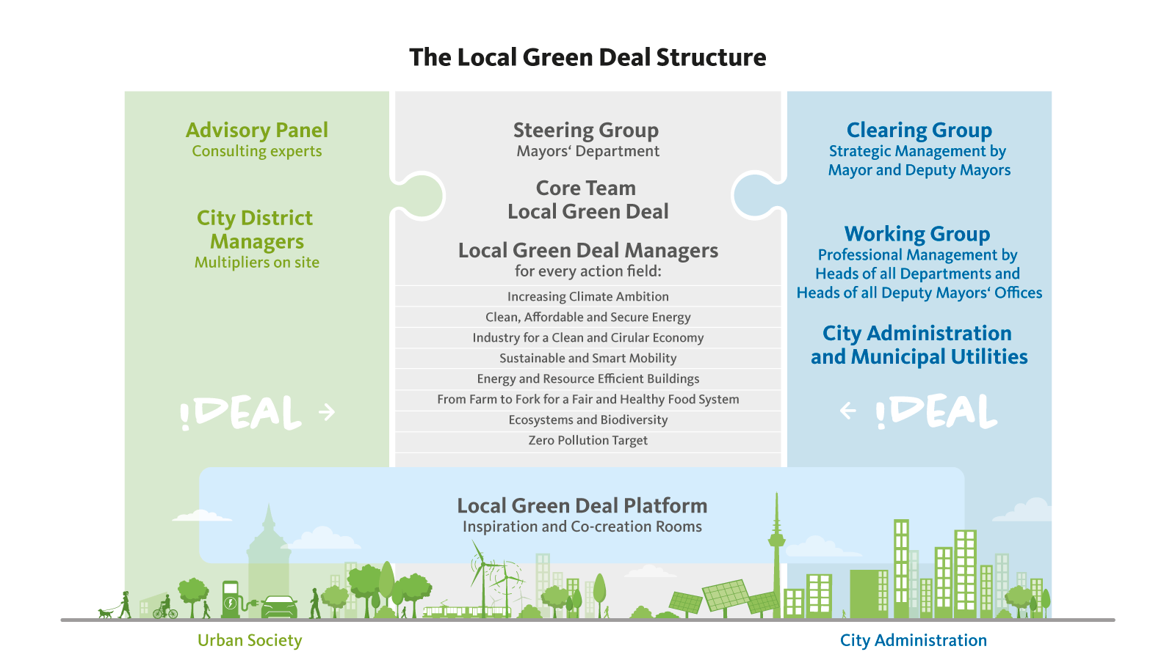
Field of action – Governance Innovation
What is the field of action of your solution?
  Energy Systems
  Mobility & Transport
  Waste & Circular Economy
  Green Infrastructure & Nature Based Solutions
  Built Environment
  Governance
  Policy and Regulation
  Social Innovation
  Citizen and Stakeholder Engagement
Can you tell us about the selected field of action in your city? → structure

Slide 8

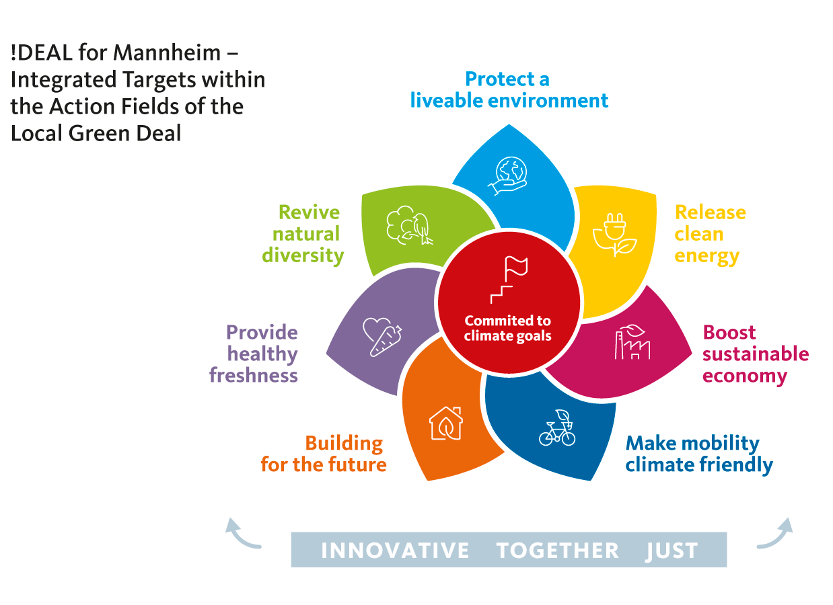
Main Lesson Learnt
Think about building collective action and co-creative collaboration from the beginning when planning strategies
Start with the core team, involve ALL departments AND politicians
Always think of co-benefits and a shared vision beyond the administration into the city society
Talk about people and their values, not CO2 emissions
The technical measures are the second step, preceded by the measures directed at human behavior (administrations are made up of people too!).
Every change in the administration is perceived and initially eyed with suspicion
The DEAL and success belongs to the actors, not the enabling/supportive governance.

Slide 9
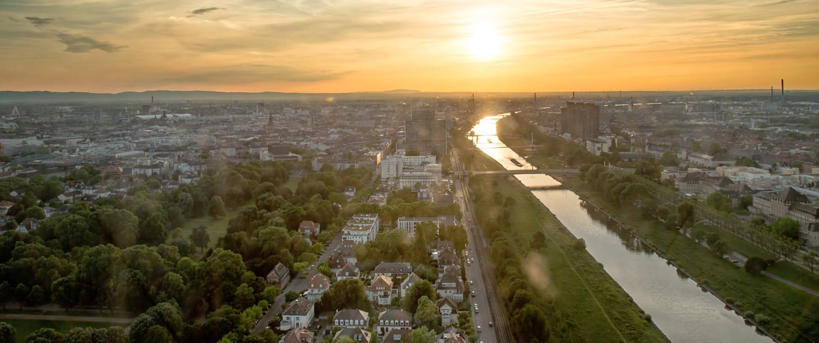
Where to find additional information
Local Green Deal Mannheim (DE)
www.mannheim.de/de/stadt-gestalten/local-green-deal
Climate Alliance of Business Mannheim (DE)
www.mannheim.de/sites/default/files/2020-01/Brosch%C3%BCre_Klimaschutz_Allianz_2020.pdf
Climate Action Agency (DE)
www.klima-ma.de
CoLAB - Committed to Local Climate Action Building German Pilot Cities Project
www.netzerocities.eu/germanys-pilot-activity-colab-committed-to-local-climate-action-building/

Slide 10
Milan

Slide 11
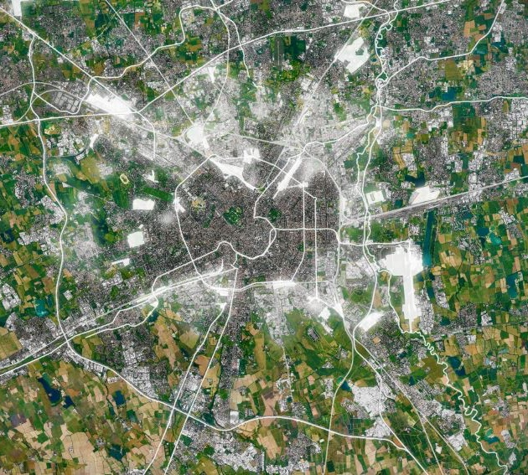
City Master Plan (art.10)
New quality standards for the building stock
Objective:
Reduce the carbon emissions
Increase green areas
Maximize the permeable surface in the city
Scope:
new buildings
renovation of existing building stock

Slide 12
GHG limits for new buildings and deep renovation
Art.10 of the Technical Rules of the City Master Plan : Zero Carbon Buildings
Objective: speed up the decarbonisation of energy uses in buildings by setting GHG emissions limits for new buildings (zero emissions) and building deep renovation
Art.10 provides a tool – to be used when asking for building permit - for CO₂ calculation that take into consideration energy performance and a set of compensating factors: Nature Based Solutions, water management, sustainable mobility, solutions to reduce the heat island effect, circularity of materials.
The monetization of residual emissions is allowed
Incentives are granted for building retrofit exceeding the limits.

Slide 13
Barrier/s addressed by the solution
The solution is applied at the local (municipal) level.
The main barrier addressed is the resistance of buildings operators to additional rules and requirements, especially when entailing additional costs.
Other challenges, besides acceptance, are setting proper GHG limits and the values for monetization, in order to be effective and enough ambitious without too much overloading operators

Slide 14
Main Lessons Learnt
A step by step approach –field test- is a good way to proceed
This regulation was introduced as «experimental», while it needs to be modified and integrated, it’s working well
Introducing this kind of requirements is feasible and manageable
Application results and the requests for clarification we received are fundamental inputs for improvement (it’s difficult to think of all the cases and potential factors affecting application without a field test)
The cooperation of many City Departments working together was a fundamental component (especially in the designing phase)

Slide 15
Where to find additional information
List of resources if any:
https://www.pgt.comune.milano.it/prnorme-di-attuazione/norme-di-attuazione/titolo-i-disposizioni-generali/capo-ii-disciplina-generale/art-10-sostenibilita-ambientale-e-resilienza-urbana
https://www.comune.milano.it/documents/20126/69896953/Documento+tecnico+Art+10+-+DD+797+del+5_02_2020.pdf/806064dd-a45d-a806-081f-18a181bf6174?t=1580915737127
https://www.comune.milano.it/aree-tematiche/rigenerazione-urbana-e-urbanistica/pgt-approvato-e-vigente-milano-2030/sostenibilita-ambientale-e-resilienza-urbana

Slide 16
Florence

Slide 17
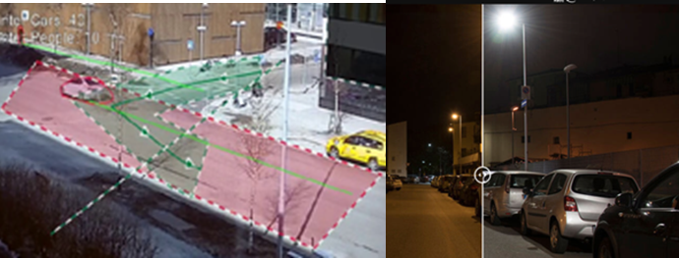

1 - Smart Lighting as systemic infrastructure
What is the solution and how does it work?
The Lighthouse city image is naturally linked to the “lighting” concept and the light is what we decided to start with because it is spread all over the district, it is highly visible, and it could have become a best practice for extension and replication.
Thanks to SCC1 Replicate project, Smart public lighting has become a valuable systemic infrastructure of the city, carrying on board additional services (like video-cameras, wi-fi, environmental sensors, traffic control systems…) with the double benefit of reducing costs and impacts. This “backbone” is connected to the Smart grid, updated to have better performances and become more resilient, as well as to our Smart City Control Room which is collecting and processing all the data gathered by the Smart lighting system and new services.
From the Replicate pilot action involving 1000 lamppost, the lighting revolution has already been extended, reaching other 5 districts with more than 30.000 new lights in streets, squares and parks.
Florence has implemented the pilot action and the extension through its third party Silfi. The business model of the project is based on costs savings: from energy bills to installation costs and maintenance of all the services the smart lighting is now equipped with.The impact on the electricity consumption, for the extension phase already started, is estimated about 12 GWh saved, with consistent direct savings on energy bills (between 1,5 and 2 million €/y depending on electricity tariffs) and on indirect potential external costs (340.000 €/y).

Slide 18
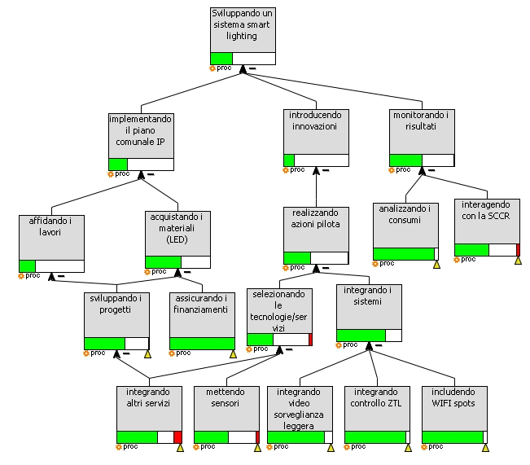
Barrier/s addressed by the solution
What barrier(s) does the developed solution address?
- systemic approach to city’s services/infrastructures, breaking silos within the administration for the implementation of a first “portfolio” of actions
- cooperation with higher level institutions (sovrintendenza)
- portfolio business model
Does the solution apply at local, regional or national level ?
The solution is going to be extended at metropolitan level
System thinking model of Florence Smart lighting
(SPES, Yearworth SCC1 Replicate 2018)

Slide 19
Field of action
What is the field of action of your solution?
  Energy Systems
  Mobility & Transport (access to limited traffic zones)
  Waste & Circular Economy
  Green Infrastructure & Nature Based Solutions
  Built Environment (public lighting)
  Governance (security, data collection, interaction of different service providers/departments to exploit synergies…)
  Policy and Regulation
  Social Innovation
  Citizen and Stakeholder Engagement (#firenzecamibaluce campaign and exemplar measure)
Can you tell us about the selected field of action in your city?

Slide 20
Main Lesson Learnt
The smart lighting is not just a mere transition to LED technology: it is an opportunity to show what systemic thinking can bring, matching energy efficiency with many other aspects for a greener, safer, more resilient and more connected city. Florence comprehensive project brings together CO2 savings, lower energy bills, lower impacts of services infrastructures, safer streets, traffic and access enhanced control, wider wifi connection and extended data collection. Our Smart public lighting is a fundamental part of the smart city design as it is actively connected to the e-distribuzione smart& resilient grid, the municipal smart city control room and directly to citizens.
It is a win-win experience, a service for the city and for the citizens.

Slide 21
Where to find additional information
www.firenzecambiauce.it
https://replicate-project.eu

Slide 22
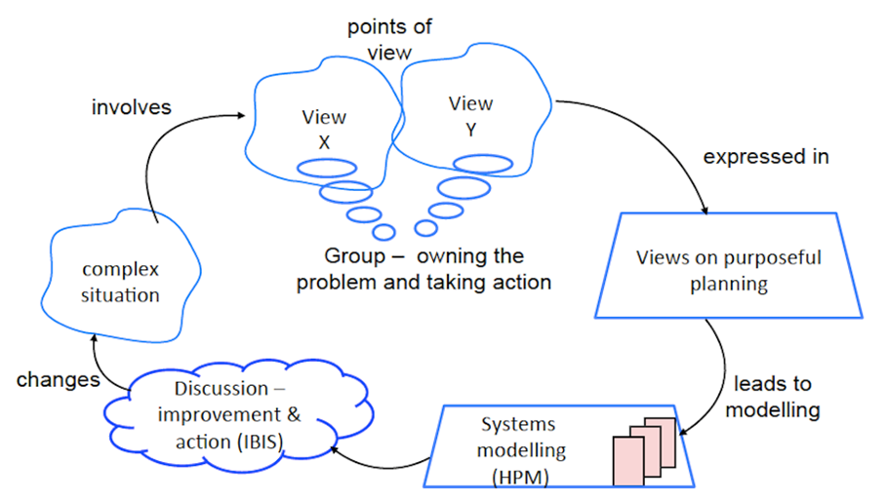
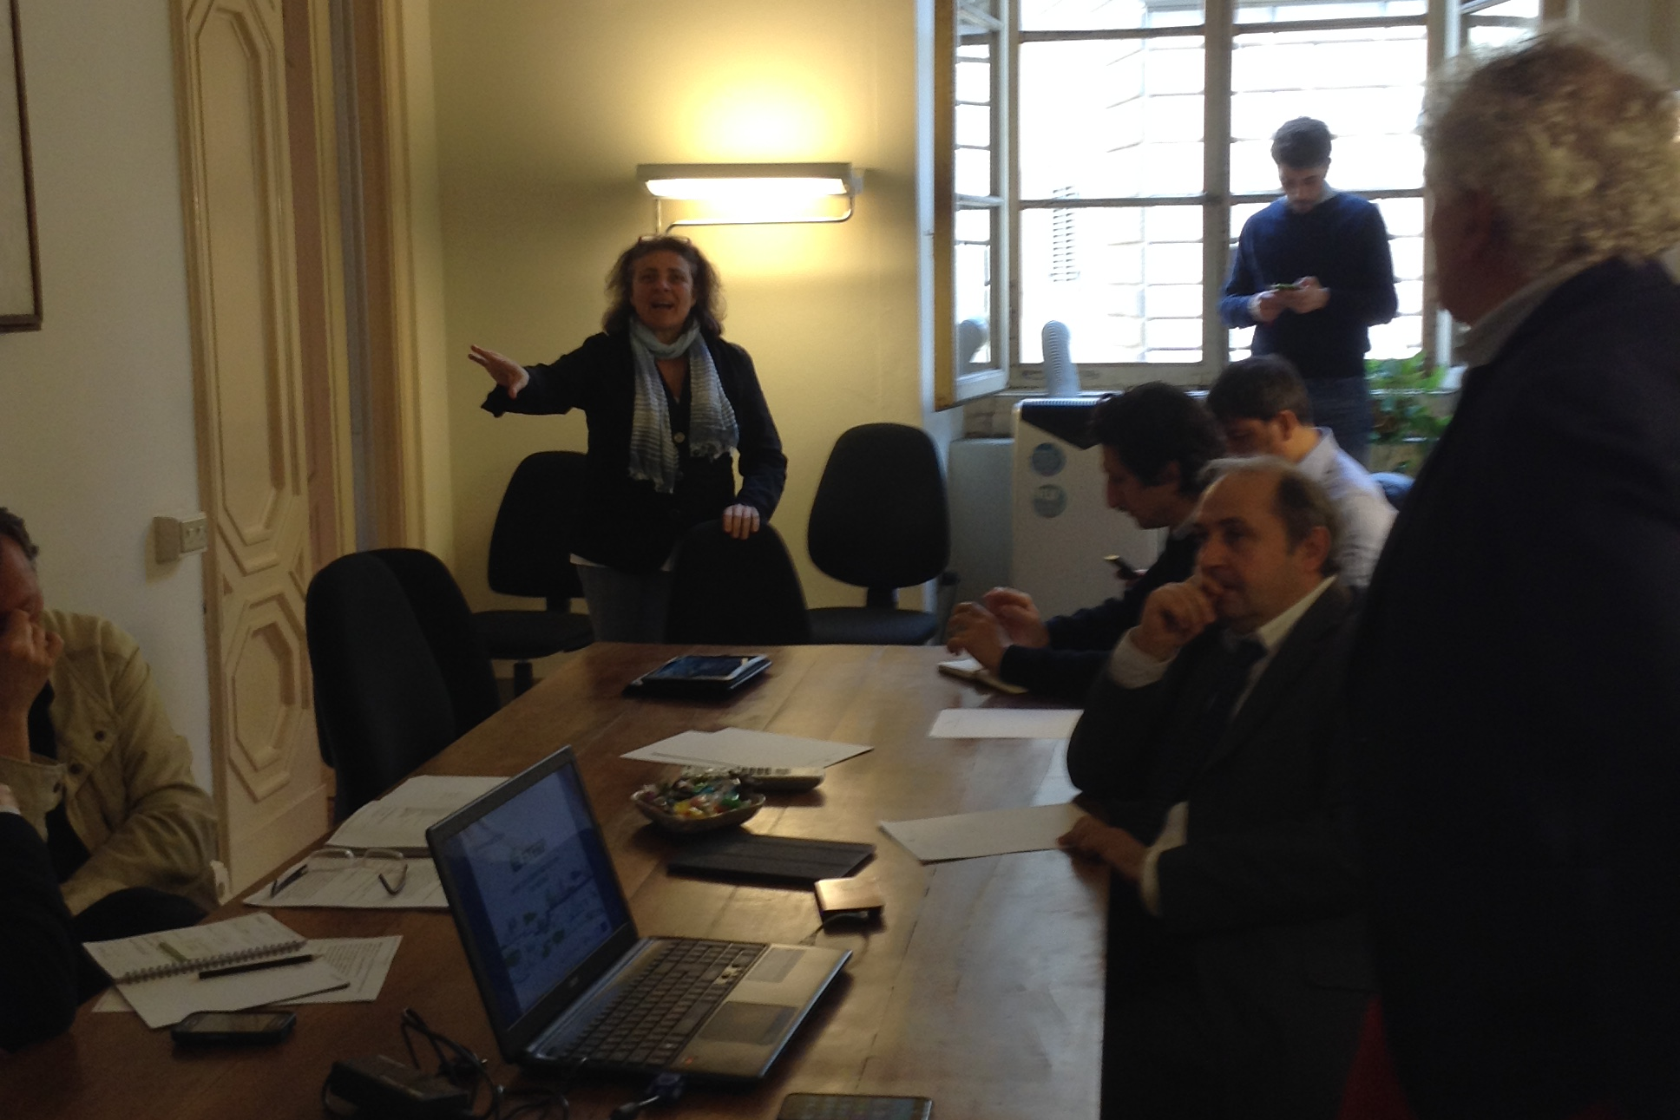
2 – Climate Task Force
What is the solution and how does it work?
The holistic outlook of Florence brought to officially set up in 2010, inspired by CoM, an interdisciplinary “task force” with specific competencies and skills to work on integrated plans like SEAP. Due to its nature and the importance of the issue, the WG was conceived as an inter-departmental body, made of 22 people, supported by technical assistance/facilitator and coordinated by the City Manager.
The WG has overseen the coordination of all following plans and programs since its foundation; it is dynamic and open to any suggestions: in accordance with the specific agendas, other stakeholders have been included in years and those not officially members but directly affected by the issues, are invited to participate in the sessions.
Since its establishment, the Group has met regularly to monitor and verify the plan's coherence and implementation, organize the analyses, follow up on the obligatory phases and promote the meetings programmed in the communication plan.
The WG is highly dynamic, adapting its configuration to different upcoming challenges (Smart City, SUMP, pandemic management and local recovery plan, …) inviting when needed internal/external components contributing to the achievement of the objectives. The WG holds regular meetings to monitor activities, tune other plans under development, benchmark and exchange with other cities and initiatives.

Slide 23
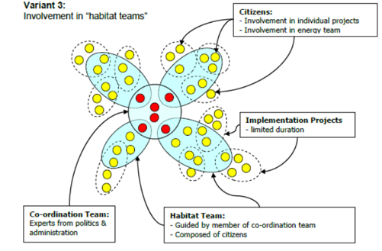

The holistic approach followed by the WG:
- a formal and strong commitment (vision as guiding principle for all integrated plans) Inclusion in the team of a policy referent (city manager) for the coordination of the activities
- the strategy: “EVERYTHING COUNTS” i.e .every suggestion and every sector
- system thinking approach developed during FP7 STEEP project for participated decision making about complex problems like energy transition and smart city development.
- interaction with several “habitat teams” formed by specific stakeholders and citizens.
The model chosen foresaw the mentioned internal group playing the role of the owner of the planning process and interacting with several “habitat teams” formed by specific stakeholders and citizens.
Every member of the internal steering group was in charge of a thematic: the internal referents coordinate the subgroups and referred to the steering team about the results. The coordination activities as well as the “sense checking” has been carried out inside the internal group.
Since 2013 the Municipality has joined the European Energy Award (eea) program to ensure a leading example and a virtuous continuous improvement of climate & energy activities supported by total quality management techniques, external expertise and regular audits. In 2016 Florence achieved the “Silver” award and in 2021 the “Gold”, maximum level.

Slide 24
Barrier/s addressed by the solution
What barrier(s) does the developed solution address?
Break internal silos
Steering & monitoring (keep people engaged, guarantee continuity of the process)
Have an external check and a support for communicating achievements and vision
Does the solution apply at local, regional or national level ?
The solution has been inherited by the CoM initiative and the EMS in use

Slide 25
Field of action
What is the field of action of your solution?
  Energy Systems
  Mobility & Transport (access to limited traffic zones)
  Waste & Circular Economy
  Green Infrastructure & Nature Based Solutions
  Built Environment (public lighting)
  Governance (security, data collection, interaction of different service providers/departments to exploit synergies…)
  Policy and Regulation
  Social Innovation
  Citizen and Stakeholder Engagement (#firenzecamibaluce campaign and exemplar measure)
Can you tell us about the selected field of action in your city?

Slide 26
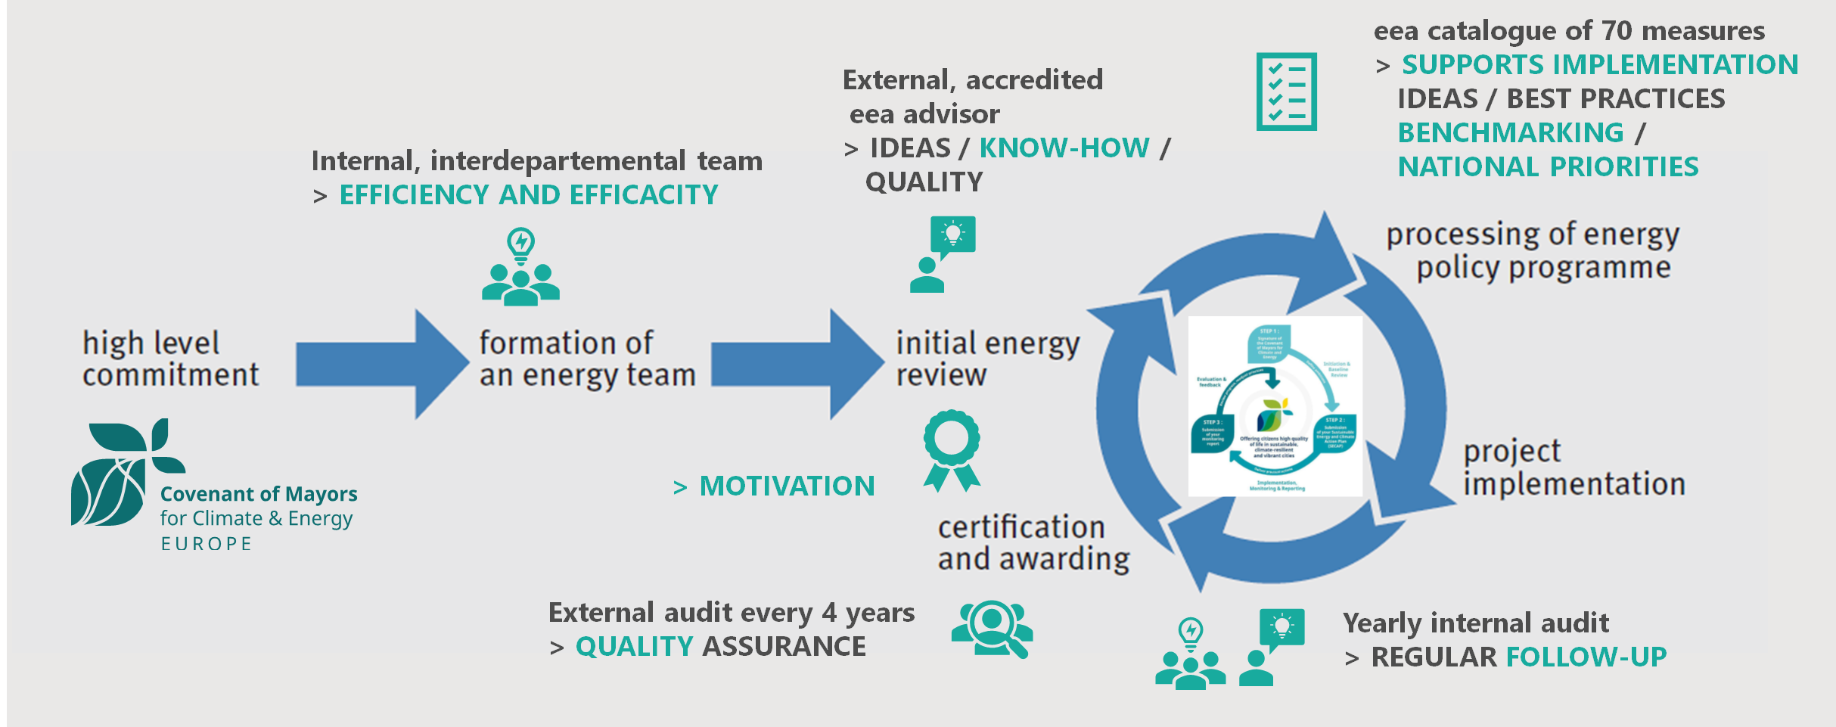
Main Lesson Learnt
The process needs a formal kickoff and the continuous support of a facilitator/team leader to keep people engaged
The results in terms of exploitation of synergies and adaptation potential are relevant
The system allows a systematic control of all activities related to energy and climate and boosts a structured continuous monitoring in term of quality and quantity of targets.

Slide 27
Where to find additional information
Smart Cities Marketplace:
  Sistemic changes in Governance https://smart-cities-marketplace.ec.europa.eu/insights/publications/systemic-changes-governance-equipping-local-governments-realising-climate
  Smart Cities Guidance Package https://smart-cities-marketplace.ec.europa.eu/news-and-events/news/2019/smart-city-guidance-package
Governance model: the interaction with stakeholders (see also Florence’s contribution to the “Stakeholders’ enagegemnt guidelines – CoME EAsy project” available on CORDIS at https://ec.europa.eu/research/participants/documents/downloadPublic?documentIds=080166e5c3b26429&appId=PPGMS )
European Energy Award www.european-energy-award.org and Florence page at https://www.european-energy-award.org/gold-municipalities-new/eea-municipality-detail/firenze

Slide 28
Malmö

Slide 29

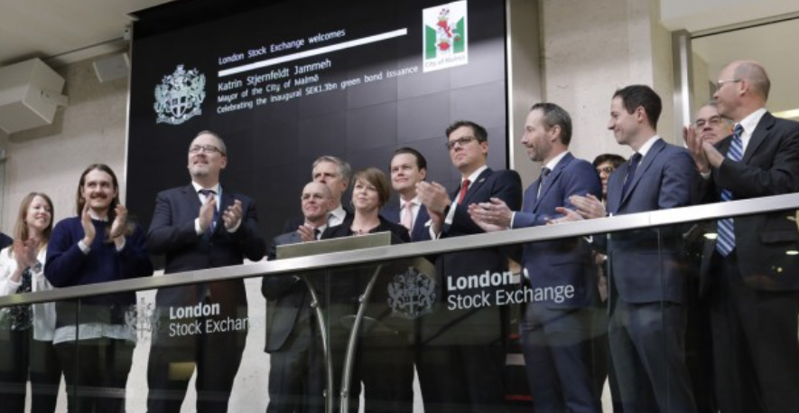
Solution – Green bonds
Green bonds and Malmö’s green bonds framework
Used to finance our climate actions and reach our climate goals
Notes:
Anna
The solution Malmö has used is green bonds and the City of Malmö green bonds framework. Green bonds are debt securities or loans to finance projects that are climate and/or environmentally friendly. IN the city of malmö green bond framework we show investors what projects and project areas are up for funding, making it easy for investors to see what their money is contributing to.
We use green bonds to finance the actions that lead to the climate and environmental goals in our environmental programme. A programme with 12 goals to 2030 connected to goals withnin climate mitigation, climate adaptation and nature based solutions.
In the green bonds framework The city of Malmö specifies projects that would lead to goal achievement. The green bonds was issued in 2018 on the London Stock Exchange.

Slide 30
Barrier/s addressed by the solution
What barrier(s) does the developed solution address?
  Challenges connected to secure increased degree of green investments
  Low, cross city, understanding of how to secure climate or sustainability demands in public procurements
  Transparency in public investments
  No structured MEL (monitoring, evaluation and learning) connected to the investments and its potential effects
Does the solution apply at local, regional or national level?
  The majority of the investments are in local actions, but some also contributes to other municipalities operations and goals
Notes:
Chrille
The implementation of the city of Malmö’s Green bonds has helped to meet the challenges connected to secure increased degree of green investments. What should we invest in and how do we monitor its effects?
During that time there where low degree of cross city understanding how to secure climate or sustainability demand in public procurements.
All investments are open to the public, but the city where lacking transparency by not ”informing” what the city invested in.
And the city didn’t have a structures MEL connected to the investments and its potential effects.
The majority of the investments are in local actions, but some also contributes to other municipalities operations and goals.

Slide 31
Field of action – financial instrument
What is the field of action of your solution?
  Energy Systems (renewable energy, energy efficiency)
  Mobility & Transport (clean transportation)
  Waste & Circular Economy (Water and wastewater management)
  Green Infrastructure & Nature Based Solutions
  Built Environment (Green and energy efficient buildings)
  Governance (Pollution prevention and control)
  Policy and Regulation
  Social Innovation
  Citizen and Stakeholder Engagement
  Climate change adaptation
Notes:
Chrille
Between 2017-2021 we issued approx. 5 billion Swedish kronor (500 million Euro) in our green bonds.
Good for taking on the measures where the city has direct control, e.g. our own construction of schools, cycle paths etc.
Example: We combined a biotope roof with solar cells. The facility is located on the roof, six floors up, and the solar cells produce more energy thanks to the cooling effect from the vegetation, which in turn also adds higher biological values ​​to the surroundings. On the biotope roof, a slightly different stock of plants has been sown and planted to get a higher variety and longer flowering time, which is important for pollinators. The solar cells have been mounted so that both shady and sunny zones are created on the roof, which means that more species can thrive and that biological diversity thereby increases. When solar cells become very hot, the production of solar electricity decreases. By covering the roof with plants instead of a black roof covering, heating is reduced and more solar energy is produced. The two systems therefore benefit each other.

Slide 32
Main Lesson Learnt
Has worked well based on our previous needs
Made us follow up effects even more and understand how to measure effects and what the measures has contributed more specific
The needs for today are different (new strategic documents and goals within climate and energy, new ways of working within Climate transition Malmö, Malmö Commitment for an including and fair climate transition )
Broader framework needed
We explore sustainability bonds that includes social bonds
Notes:
Anna
The green bonds have filled its purpouse leading to more investment in sustainable local actions.
Follow up and measurement are very important to first calculate and then follow up when working with sustainable investments to show that the investments in fact led to what they were supposed to.
It also gave us more experience following up effects and showing the investors what positive benefits their investments made in the city.
But now the framework has to be broadened and include more aspects of sustainability than before. On aspect is including more od the social aspect of sustainability since we in Malmö compared to other swedish citites have more social challenges such as socia-economic challenges and inclusion.

Slide 33
Where to find additional information
Green bond framework
Second-party opinion of Malmö Green bond framework
The principles Malmö has based its framework on
ICMA Green bond principles
General information about funding

Slide 34
Aachen

Slide 35
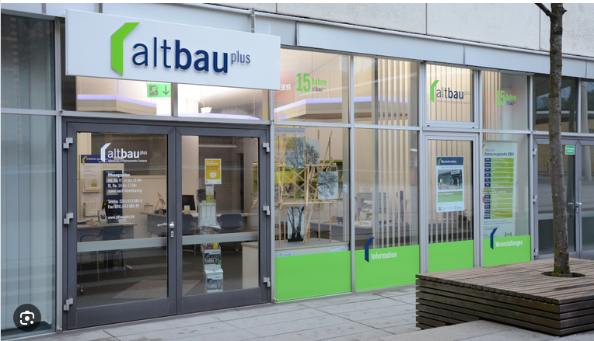
Aachen solution: the advisory office “altbau plus”
In 2004 the advisory office “altbau plus” was founded as a non-profit association on the initiative of the City of Aachen.
Aims:
  increase willingness of private home owners to renovate
  provide qualified and comprehensible information and to actively promote climate protection
  bundle competencies in a neutral, citizen-oriented point of contact
Notes:
The City has set up an advisory service center for the topic of building refurbishment. “Altbau plus” offers a wide range of consulting and organises thematic events to private house owners. In the district “Aachen North”, information work has been very intensified. As a result, the neighborhood-specific, annual renovation rate has been increased by 5%. Work at the district level will be expanded. For this purpose, the situation in the respective neighborhoods will be analyzed in advance in order to tailor the approach and advice to the target groups. Information and consulting on the subject of RE-based heating will also be a focus. www.aachen.de/altbau

Slide 36
Barrier/s addressed by the solution
Poor renovation rates; lack of neutral bundled information (technical and on funding)
Thus:
  the company form is a registered association (“e.V.”)
  members are the City, organizations, associations, institutions and universities that finance altbau plus with their contributions.
  they also contribute in various ways and put their skills at the service of the association
  the neutrality and independency stipulated in the statutes has always been of highest priority
Altbau plus is a local solution

Slide 37
Field of action
What is the field of action of your solution?
  Energy Systems
  Mobility & Transport
  Waste & Circular Economy
  Green Infrastructure & Nature Based Solutions
  Built Environment
  Governance
  Policy and Regulation
  Social Innovation
  Citizen and Stakeholder Engagement
Can you tell us about the selected field of action in your city?
  altbau plus is an early example around a one-stop-shop solution around the topic of building refurbishment. It offers consultation and regular events - for non-professionals as well as for experts (architects, engineers, craftsmen). It will be developed further and is regarded as important member organization of the local transition team

Slide 38
Main Lesson Learnt
The altbau plus advisory service has triggered investments in buildings:
  Consulting services of an average of 1200 people per year
  Additionally, around 2500 people attend events annually
  47 percent have implemented energy-related measures in their buildings
  67.000 EUR are invested on average per measure
  Renovation rates have been increased by 5%
  Has been a successful model for a long time, but times and needs have changed:
  Within the multi-city pilot project CoLAB: The mandate will be significantly expanded towards a full climate agency that will cover more sectors and aims to reach all stakeholders. It will also be the contact point to the local ecosystem in order to promote the local CCC.

Slide 39
Where to find additional information
Altbauplus.de
https://netzerocities.eu/germanys-pilot-activity-colab-committed-to-local-climate-action-building/
Feel free to reach out:
Kristine Hess-Akens, City of Aachen
Staff Unit: Strategic Projects, EU-Mission "100 Climate Neutral and Smart Cities 2030“
Kristine.hess-akens@mail.aachen.de
+49 241 432 6002

Slide 40
Guimaraes

Slide 41
Energy efficiency office (2019)
A dedicated office aimed at optimizing energy consumption, climate change mitigation, in line with sustainability policies.
  Objectives:
    Manage municipal buildings, equipment’s and public lighting energy consumptions (contracts and performance)
    Improve energy efficiency and costs reduction
    Promote energy transition in municipal buildings and equipment’s
    Promote renewable energy
    Quantify and reduce the municipality carbon footprint (GHG inventory)
    Innovation and continuous improvement

Slide 42
Barrier/s addressed by the solution
What barrier(s) does the developed solution address?
  Expertise and Technical Support
  Conducting energy consumption assessments to better understand the municipal energy performance
  Quantifying and evaluate the municipality GHG emissions
  Assisting in climate actions projects, funding and finance
  Collaborating with external partners, consultants, and energy service companies for specialized expertise.
  Facilitating collaboration and communication among different departments
Does the solution apply at local, regional or national level ? Yes, however…

Slide 43
Field of action
What is the field of action of your solution?
  Energy Systems
  Mobility & Transport
  Waste & Circular Economy
  Green Infrastructure & Nature Based Solutions
  Built Environment
  Governance
  Policy and Regulation
  Social Innovation
  Citizen and Stakeholder Engagement
Can you tell us about the selected field of action in your city?

Slide 44
Main Lesson Learnt
Internal resources ensures critical thinking and adequate and constructive work.
Engaging a team creates the sense of commitment.
Effective data collection and monitoring is crucial for tracking progress and identifying improvement opportunities.
Collaborating with internal departments, external organizations, and energy experts enhances knowledge sharing and progress.

Slide 45
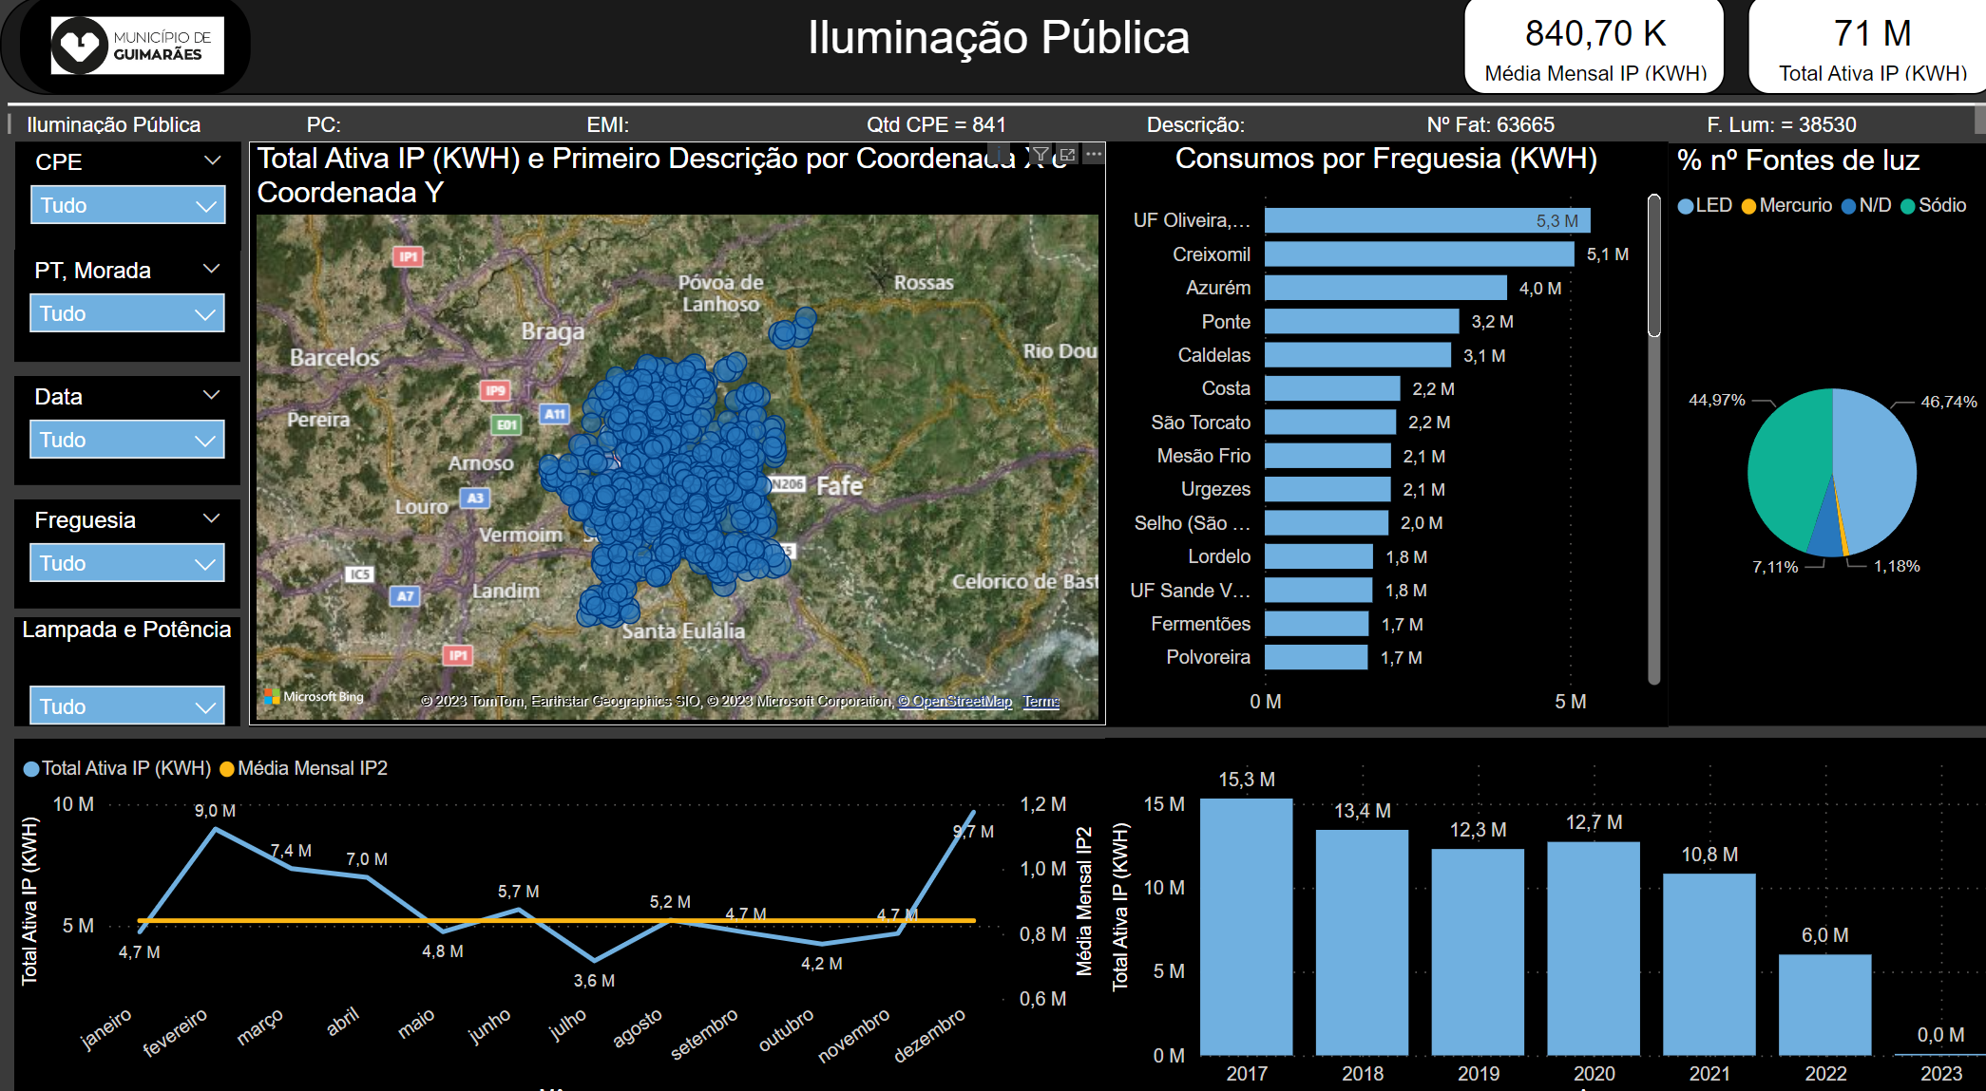
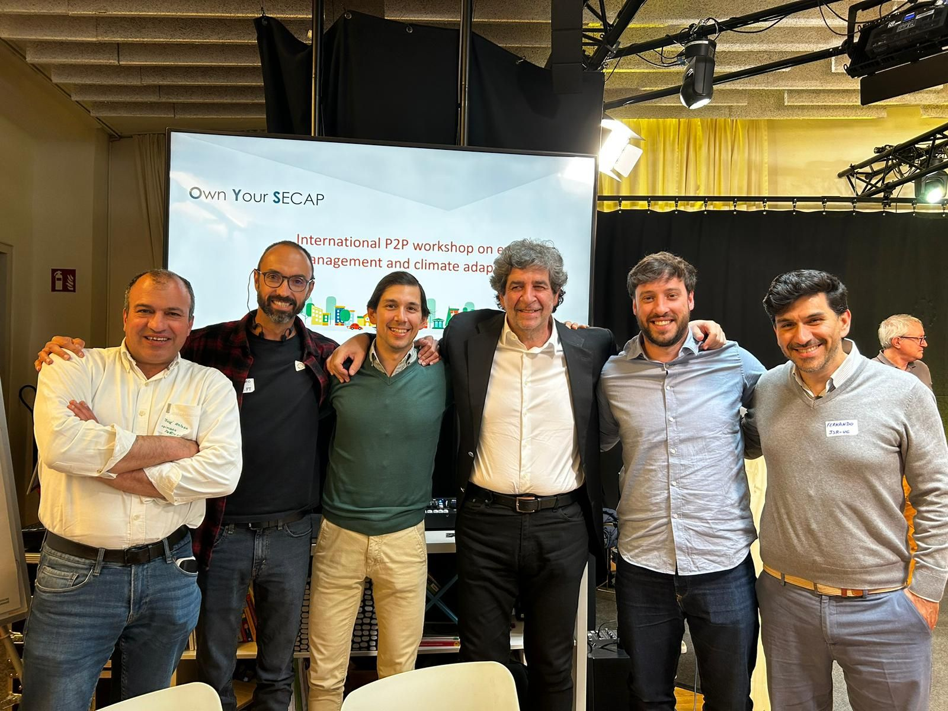
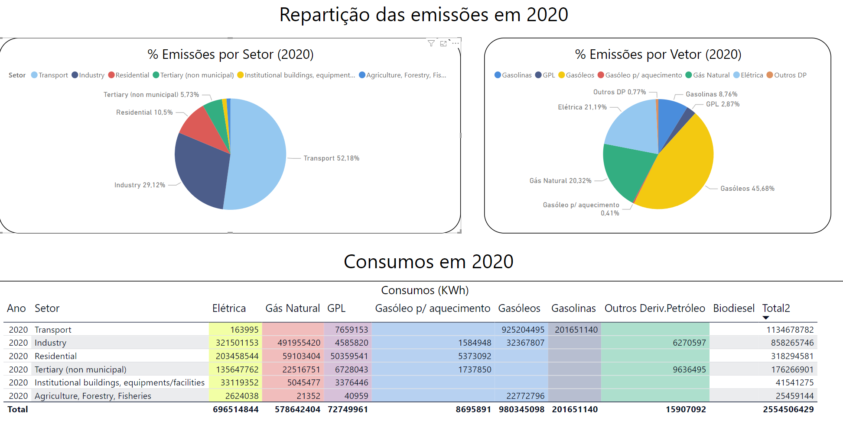

Slide 46
Bologna

Slide 47
Parma

Slide 48
Kosice

Slide 49
Wrap Up

